Slide 1
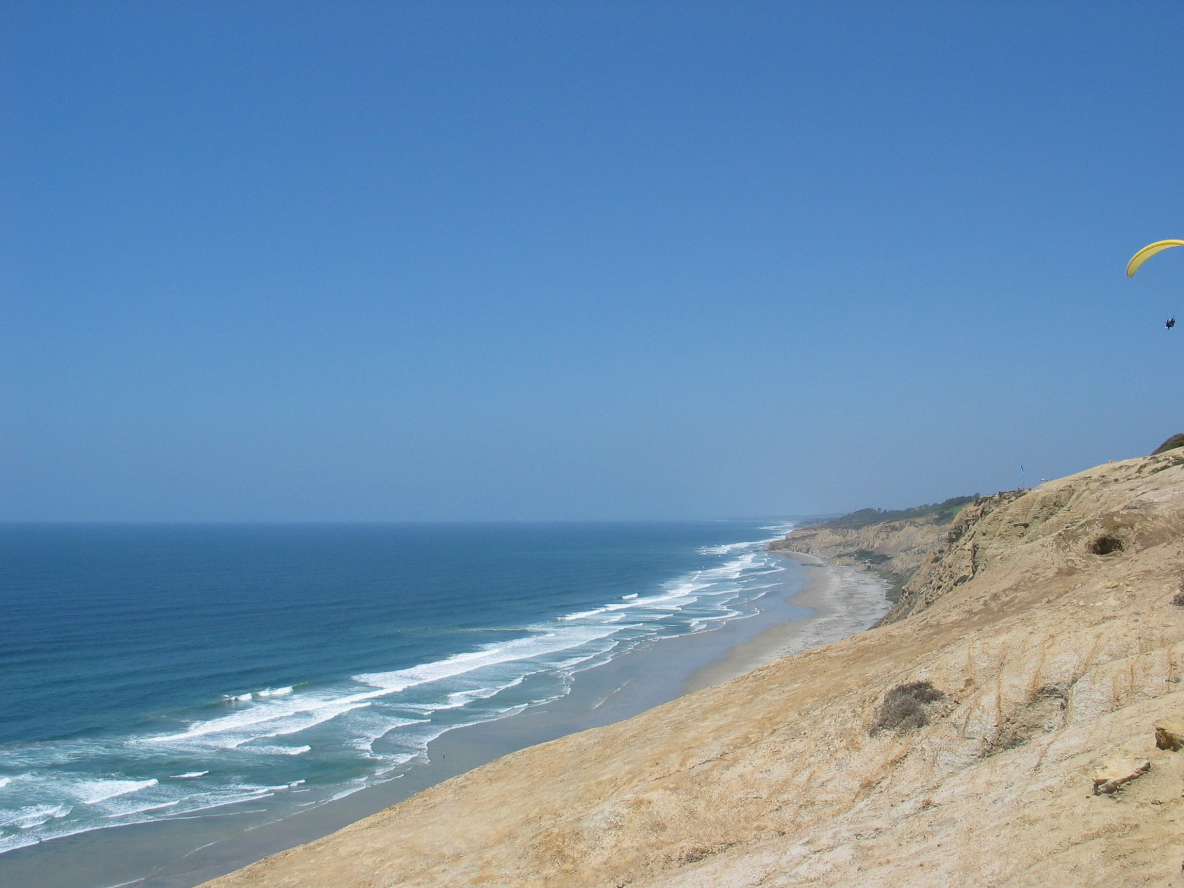
ROMS Nesting:
Composite and Refined Grids
Hernan G. Arango
Department of Marine and Coastal Sciences
Rutgers University, New Brunswick, NJ, USA
Boulder, CO
NCAR Mesa Lab
April 25, 2016

Slide 2
ROMS Nesting is very unique:
Inspiration

Slide 3
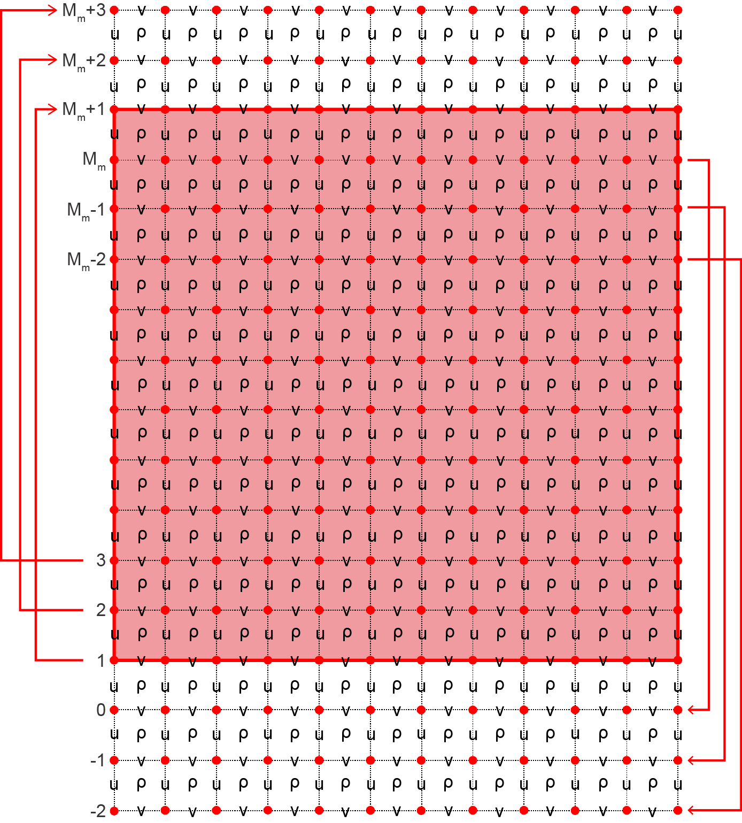
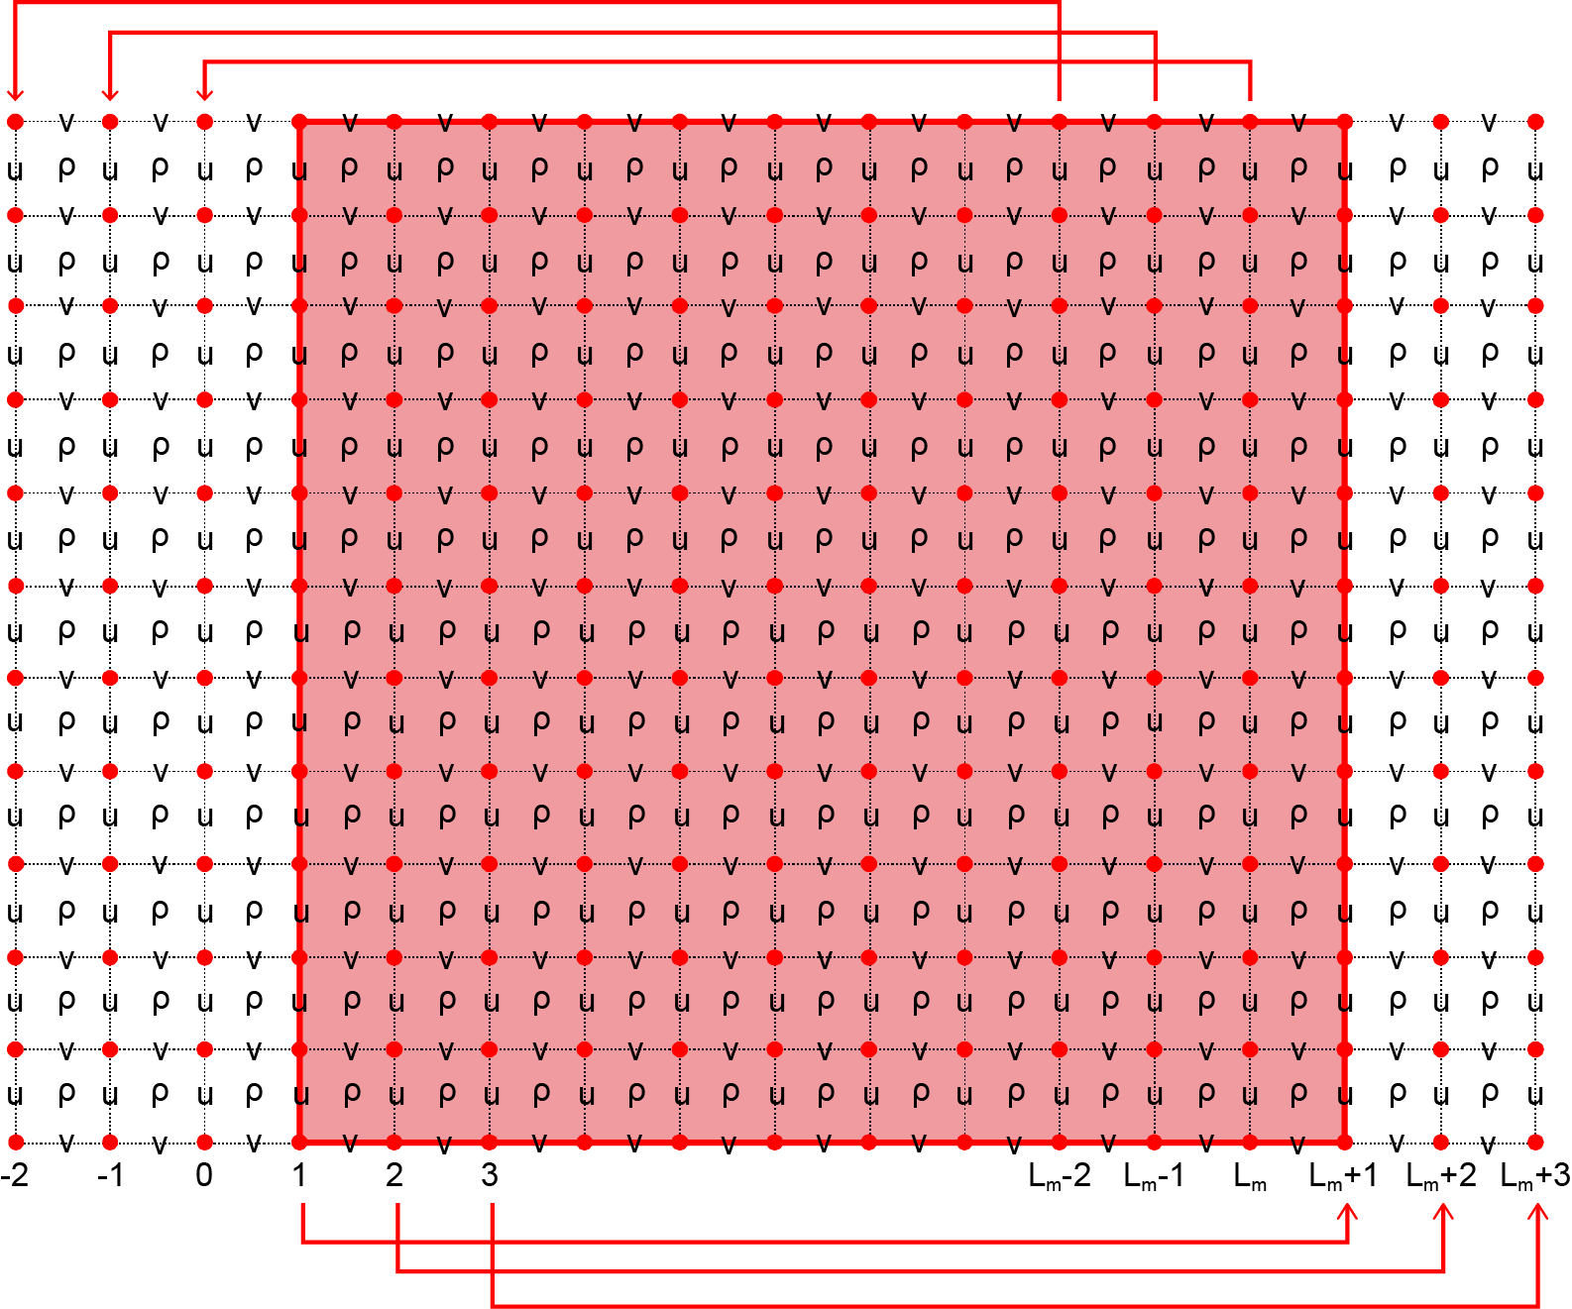
Nesting Inspiration
East-West Periodic
North-South Periodic

Slide 4
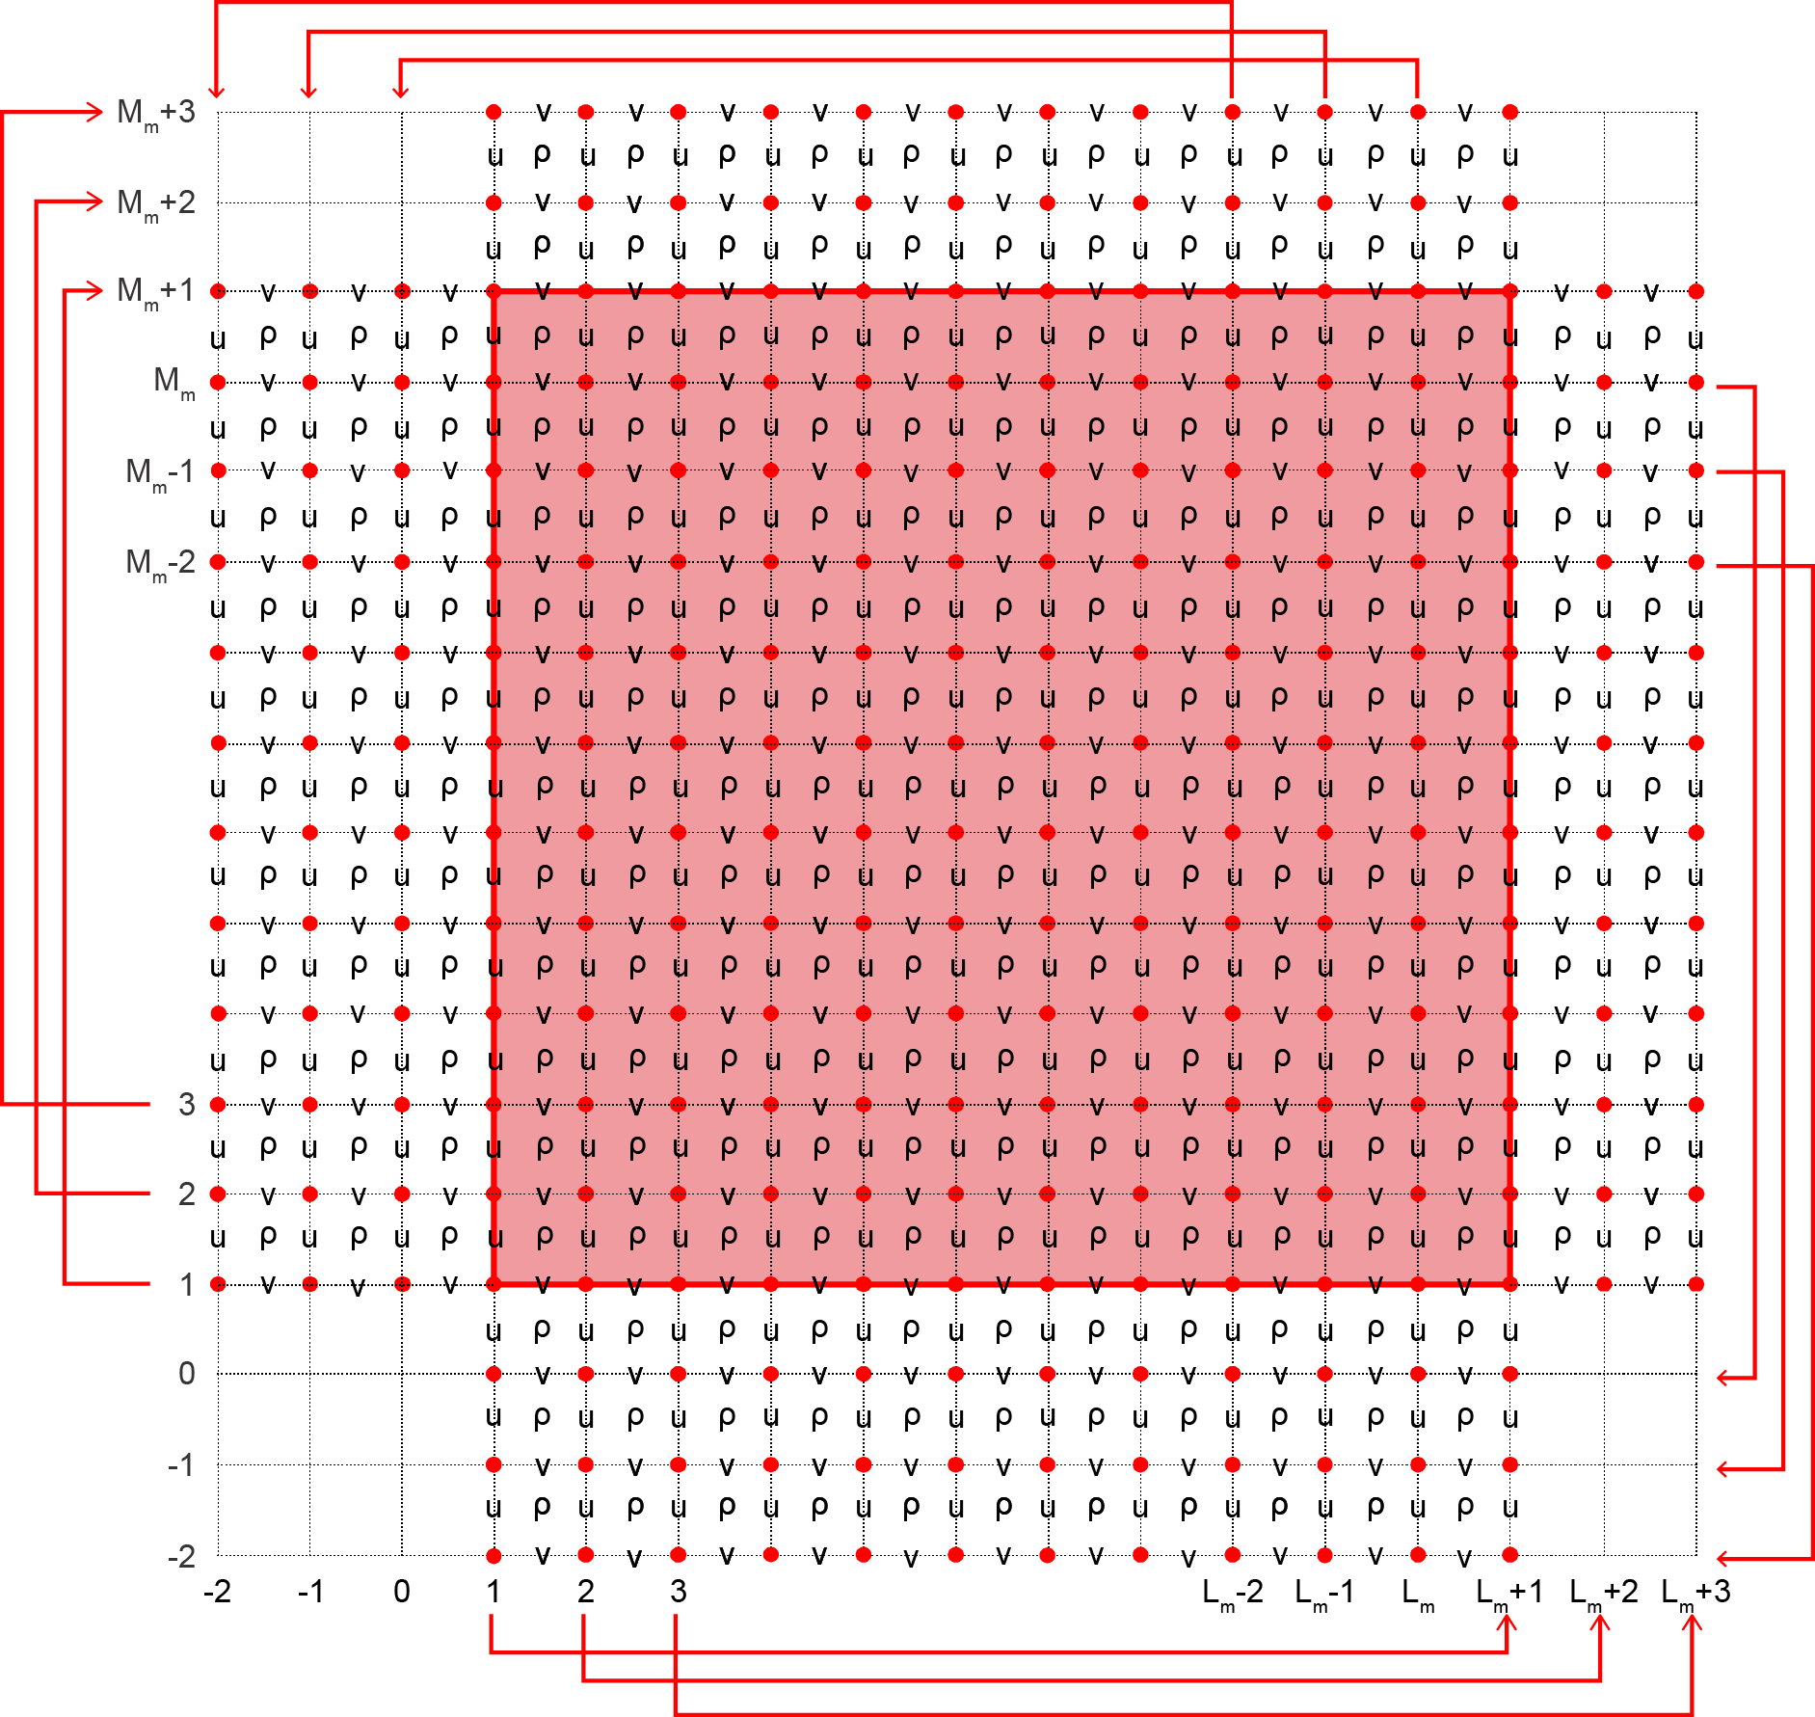
Nesting Inspiration
Double Periodic

Slide 5
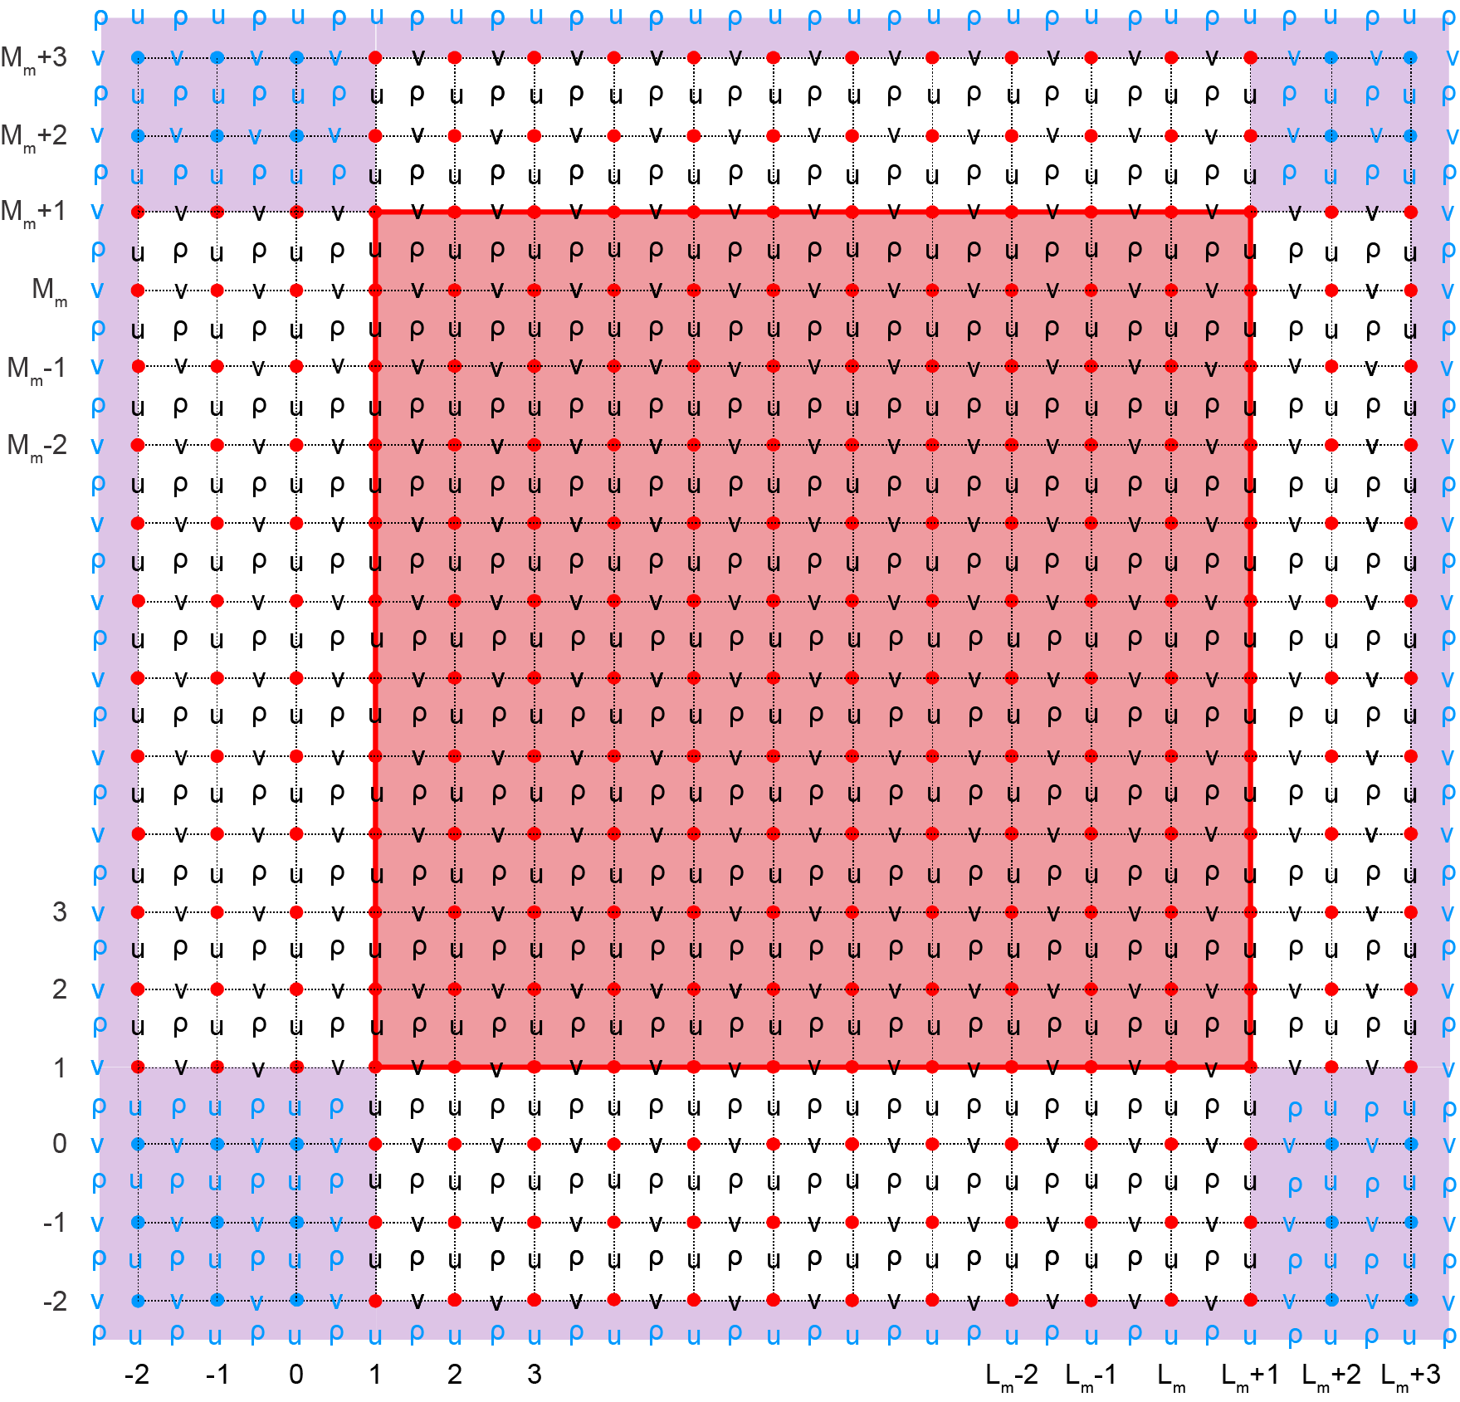
Nesting Inspiration
Double Periodic to Refinement

Slide 6
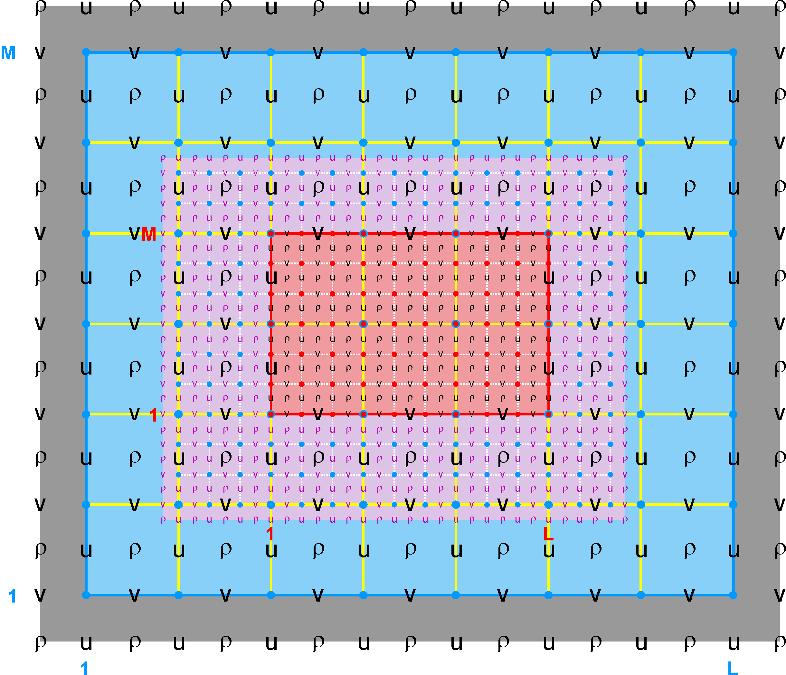
Nested Grids: Refinement Class
Ngrids = 2
NestLayers = 2
GridsInLayer = 1 1
Ncontact = 2
Donor Grid = blue
Receiver Grid = red

Slide 7
Nesting Development Strategy
The nesting option is implemented in three phases:
Phase I, released on April 2011 as version 3.5: Change ROMS numerical kernels (NLM, TLM, RPM, ADM) to allow different horizontal i- and j-ranges in DO-loops to permit operations on various nested grid classes (refinement, mosaics, and composite) and nesting layers (refinement and composite combinations).
This facilitates the computation of any horizontal operator (advection, diffusion, gradient, etc.) in the nesting overlap regions and avoids the need for cumbersome lateral boundary conditions on the model variables and their associated flux/gradient values. The advantage of this approach is that it is generic to any discrete horizontal operator. The overlap region is an extended section of the grid that overlays an adjacent grid.
The strategy is to compute the full horizontal operator at the contact points between nested grids instead of specifying boundary conditions.

Slide 8
Tile I- and J-Ranges
Istr = BOUNDS(ng) % Istr (tile)
IstrB = BOUNDS(ng) % IstrB (tile)
IstrM = BOUNDS(ng) % IstrM (tile)
IstrP = BOUNDS(ng) % IstrP (tile)
IstrR = BOUNDS(ng) % IstrR (tile)
IstrT = BOUNDS(ng) % IstrT (tile)
IstrU = BOUNDS(ng) % IstrU (tile)
Iend = BOUNDS(ng) % Iend (tile)
IendB = BOUNDS(ng) % IendB (tile)
IendP = BOUNDS(ng) % IendP (tile)
IendR = BOUNDS(ng) % IendR (tile)
IendT = BOUNDS(ng) % IendT (tile)
Jstr = BOUNDS(ng) % Jstr (tile)
JstrB = BOUNDS(ng) % JstrB (tile)
JstrM = BOUNDS(ng) % JstrM (tile)
JstrP = BOUNDS(ng) % JstrP (tile)
JstrR = BOUNDS(ng) % JstrR (tile)
JstrT = BOUNDS(ng) % JstrT (tile)
JstrV = BOUNDS(ng) % JstrV (tile)
Jend = BOUNDS(ng) % Jend (tile)
JendB = BOUNDS(ng) % JendB (tile)
JendP = BOUNDS(ng) % JendP (tile)
JendR = BOUNDS(ng) % JendR (tile)
JendT = BOUNDS(ng) % JendT (tile)
Istrm3 = BOUNDS(ng) % Istrm3 (tile) Istr-3
Istrm2 = BOUNDS(ng) % Istrm2 (tile) Istr-2
Istrm1 = BOUNDS(ng) % Istrm1 (tile) Istr-1
IstrUm2 = BOUNDS(ng) % IstrUm2 (tile) IstrU-2
IstrUm1 = BOUNDS(ng) % IstrUm1 (tile) IstrU-1
Iendp1 = BOUNDS(ng) % Iendp1 (tile) Iend+1
Iendp2 = BOUNDS(ng) % Iendp2 (tile) Iend+2
Iendp2i = BOUNDS(ng) % Iendp2i (tile) Iend+2 interior
Iendp3 = BOUNDS(ng) % Iendp3 (tile) Iend+3
Jstrm3 = BOUNDS(ng) % Jstrm3 (tile) Jstr-3
Jstrm2 = BOUNDS(ng) % Jstrm2 (tile) Jstr-2
Jstrm1 = BOUNDS(ng) % Jstrm1 (tile) Jstr-1
JstrVm2 = BOUNDS(ng) % JstrVm2 (tile) JstrV-2
JstrVm1 = BOUNDS(ng) % JstrVm1 (tile) JstrV-1
Jendp1 = BOUNDS(ng) % Jendp1 (tile) Jend+1
Jendp2 = BOUNDS(ng) % Jendp2 (tile) Jend+2
Jendp2i = BOUNDS(ng) % Jendp2i (tile) Jend+2 interior
Jendp3 = BOUNDS(ng) % Jendp3 (tile) Jend+3
Suffix:
R : tile RHO-points B : Boundary tile RHO- and V-points
U : tile U-points M : Boundary tile PSI- and U-points
V : tile V-points P : Nesting PSI-, U-, and V-points
T : Nesting RHO-points

Slide 9
Boundary Tile Indices
If not nesting grids, the additional boundary tile indices associated with nesting are set to:
IstrT = IstrR full range, starting I- direction (RHO-point)
IendT = IendR full range, ending I- direction (RHO-point)
JstrT = JstrR full range, starting J- direction (RHO-point)
JendT = JendR full range, ending J- direction (RHO-point)
IstrP = Istr full range, starting I- direction (PSI-, U-point)
IendP = Iend full range, ending I- direction (PSI-point)
JstrP = Jstr full range, starting J- direction (PSI-, V-point)
JendP = Jend full range, ending J- direction (PSI-point)
IstrB = Istr interior range, starting I- direction (RHO-, V-point)
IendB = Iend interior range, ending I- direction (RHO-, V-point)
JstrB = Jstr interior range, starting J- direction (RHO-, U-point)
JendB = Jend interior range, ending J- direction (RHO-, U-point)
IstrM = IstrU interior range, starting I- direction (PSI-, U-point)
JstrM = JstrV interior range, starting J- direction (PSI-, V-point)

Slide 10
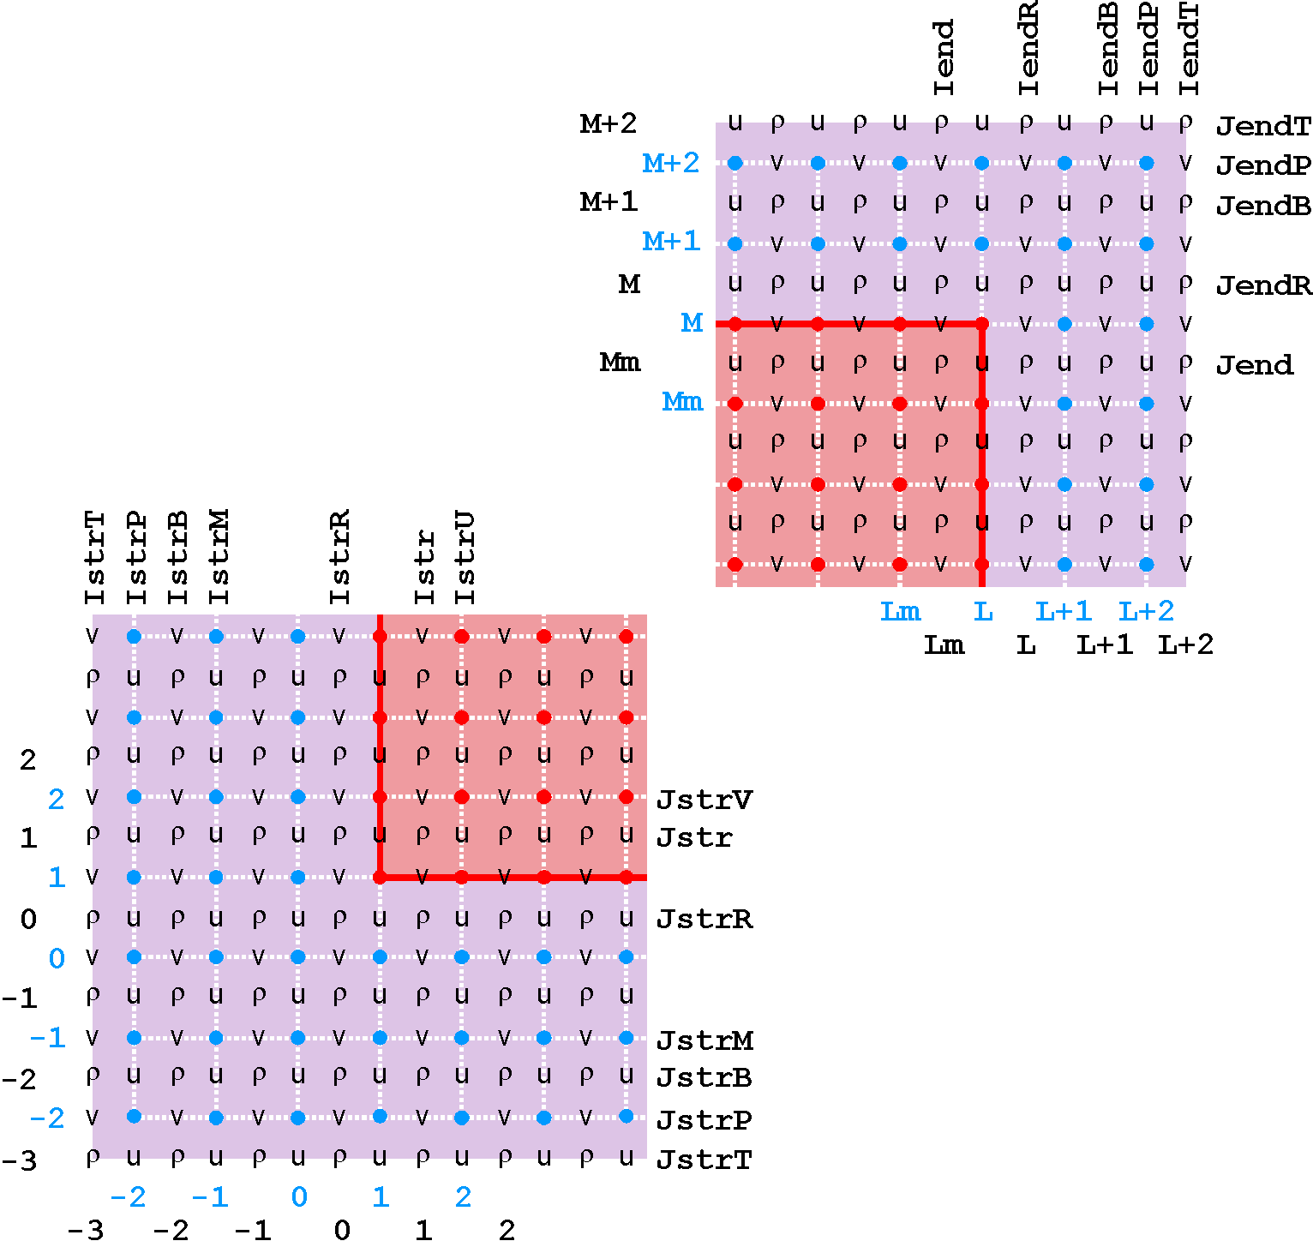
Boundary Tile Indices Locations

Slide 11
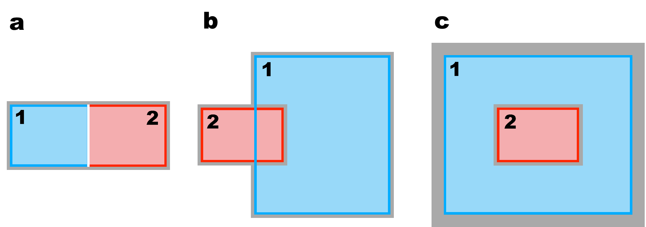
Nesting Classes
Mosaic
Composite
Refinement

Slide 12
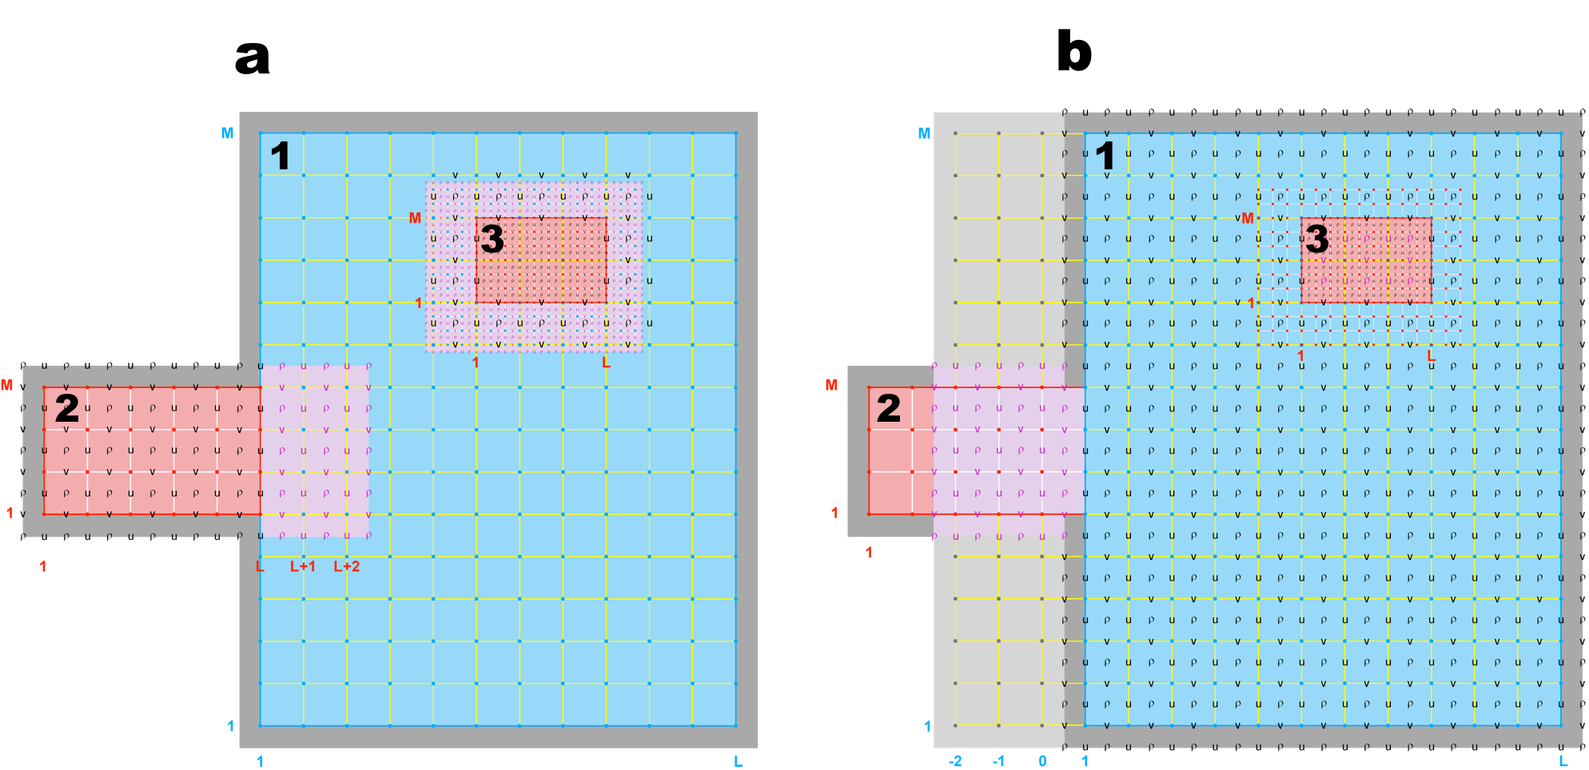
Contact Areas and Points
Refinement-Composite Sub-Class

Slide 13
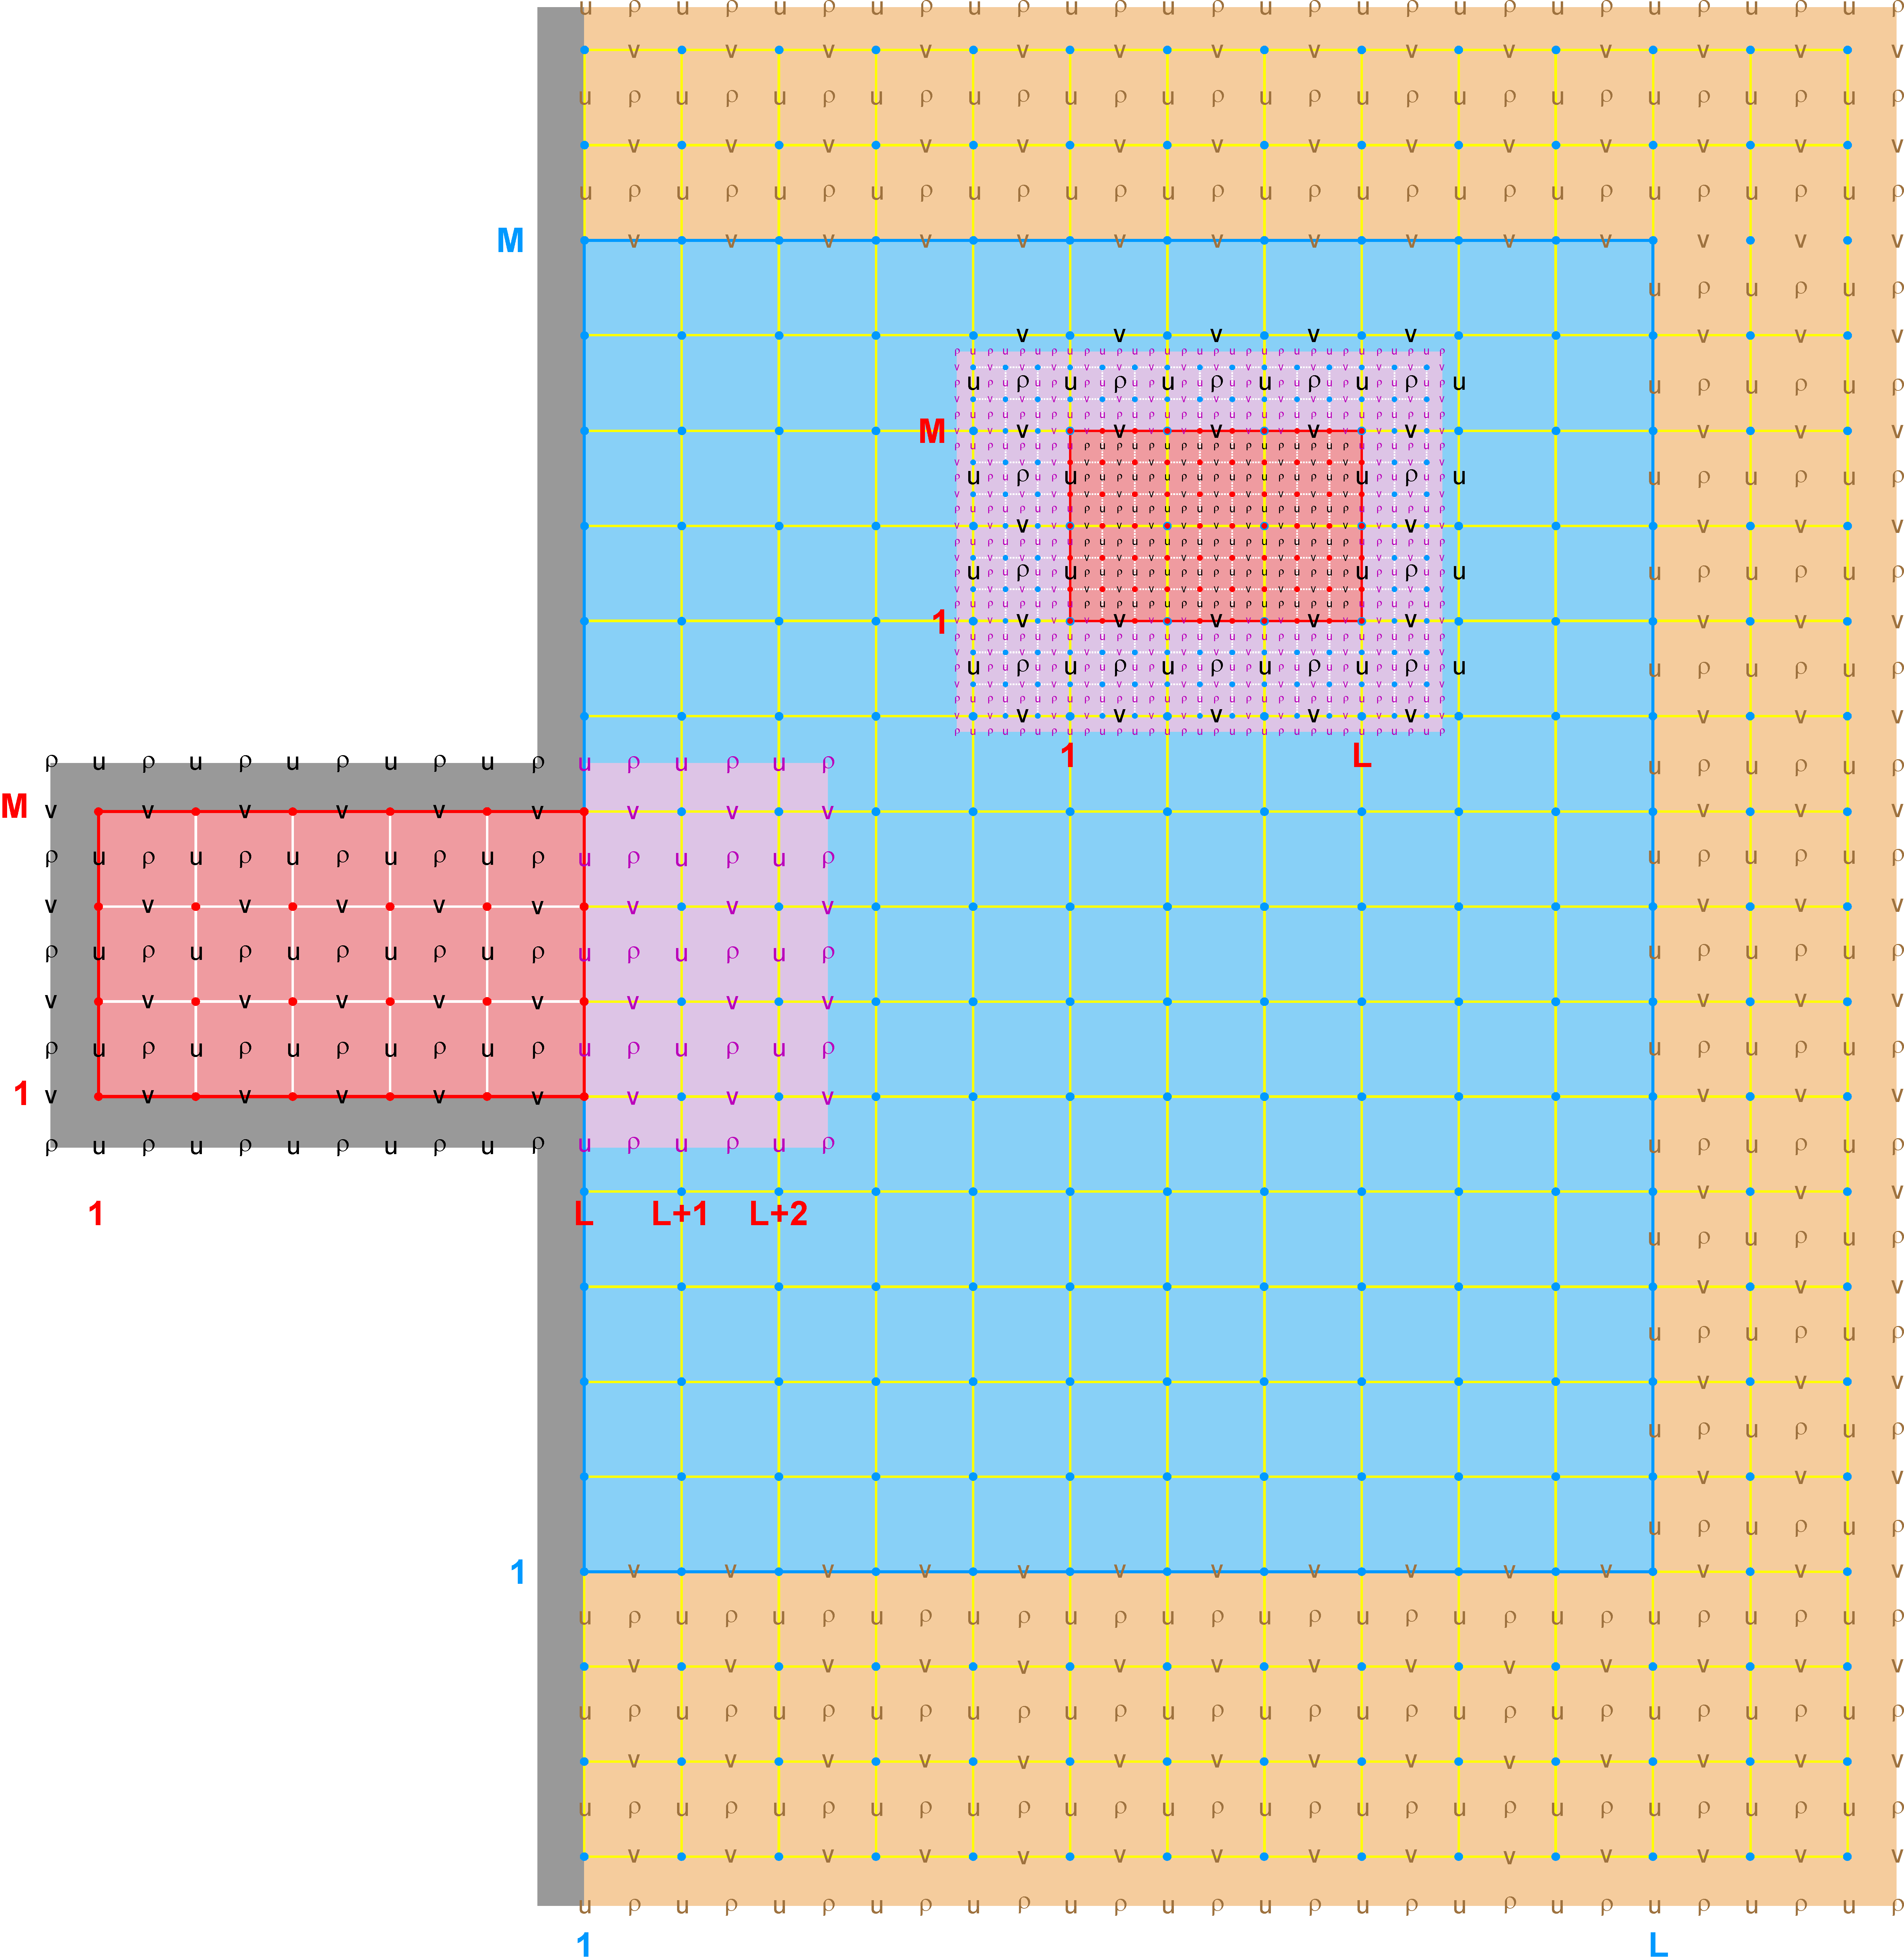
Heterogeneous Model Nesting
(One-Way Open boundary Conditions)

Slide 14
Contact Areas and Points: Definitions
Contact Region (cr): Extended section of the nested grid that overlays an adjacent nested grid. It is the region where the exchange of data between nested grids takes place. Since ROMS nesting is two-way by default, there are Ncontact=(Ngrids-1)*2 contact regions, where Ngrids is the number of nested grids and Ncontact is the number of contact regions in a nested application. There is a duality in ROMS grid nesting: data donor in one contact region and data receiver in its conjugate contact region. Each contact region has a donor and a receiver grid.
Contact Points: Grid cells inside a contact region. Since ROMS governing equations are solved in an Arakawa C-grid, there are contact points at ρ-, Ψ-, u-, and v-points. However, the Ψ-points are only used to define the physical grid perimeters within a contact region. Since the C-grid stencil indices in ROMS are left-bottom ordered, there are always 4 ρ contact points at the left and bottom side of the contact region. On the other hand, there are 3 ρ contact points on the right and top side of the contact region.
Donor Grid (dg): Data source grid in a nesting contact region. In refinement, the donor grid is used either to interpolate data from coarse to fine grid or to average data from fine to coarse grid (two-way feedback).
Receiver Grid (rg): Data recipient grid in a nesting contact region. In refinement, the contact points of the finer receiver grid are interpolated using the coarser donor data from the grid cell containing the contact point. The interpolation can be linear or quadratic. In two-way nesting, when the coarse grid is the receiver grid the finer grid solution is averaged within the coarse cell. The coarse grid cell value is replaced with the finer grid averaged solution. This takes place in routine fine2coarse.
Nesting Layer: Nested grids time-step arrangement and order for the ROMS numerical kernel. It is directly related to the time-step size (dt) for each nested grid. The number of nested layers, NestLayers, is specified in standard input script (ocean.in) and should be equal to the different number of time-step size (dt).

Slide 15
Standard Input File: Rivers and Sponges
Logical switches (TRUE/FALSE) to activate horizontal momentum transport point Sources/Sinks (like river runoff transport) and mass point Sources/Sinks (like volume vertical influx), [1:Ngrids].
LuvSrc == 3*F ! horizontal momentum transport
LwSrc == 3*F ! volume vertical influx
Logical switches (TRUE/FALSE) to activate tracers point Sources/Sinks (like river runoff) and to specify which tracer variables to consider: [1:NAT+NPT,Ngrids]. See glossary below for details.
LtracerSrc == 2*F 2*F 2*F ! temperature, salinity, inert
Logical switches (TRUE/FALSE) to increase/decrease horizontal viscosity and/or diffusivity in specific areas of the application domain (like sponge areas) for the desired application grid.
LuvSponge == 3*F ! horizontal momentum
LtracerSponge == 2*F 2*F 2*F ! temperature, salinity, inert

Slide 16
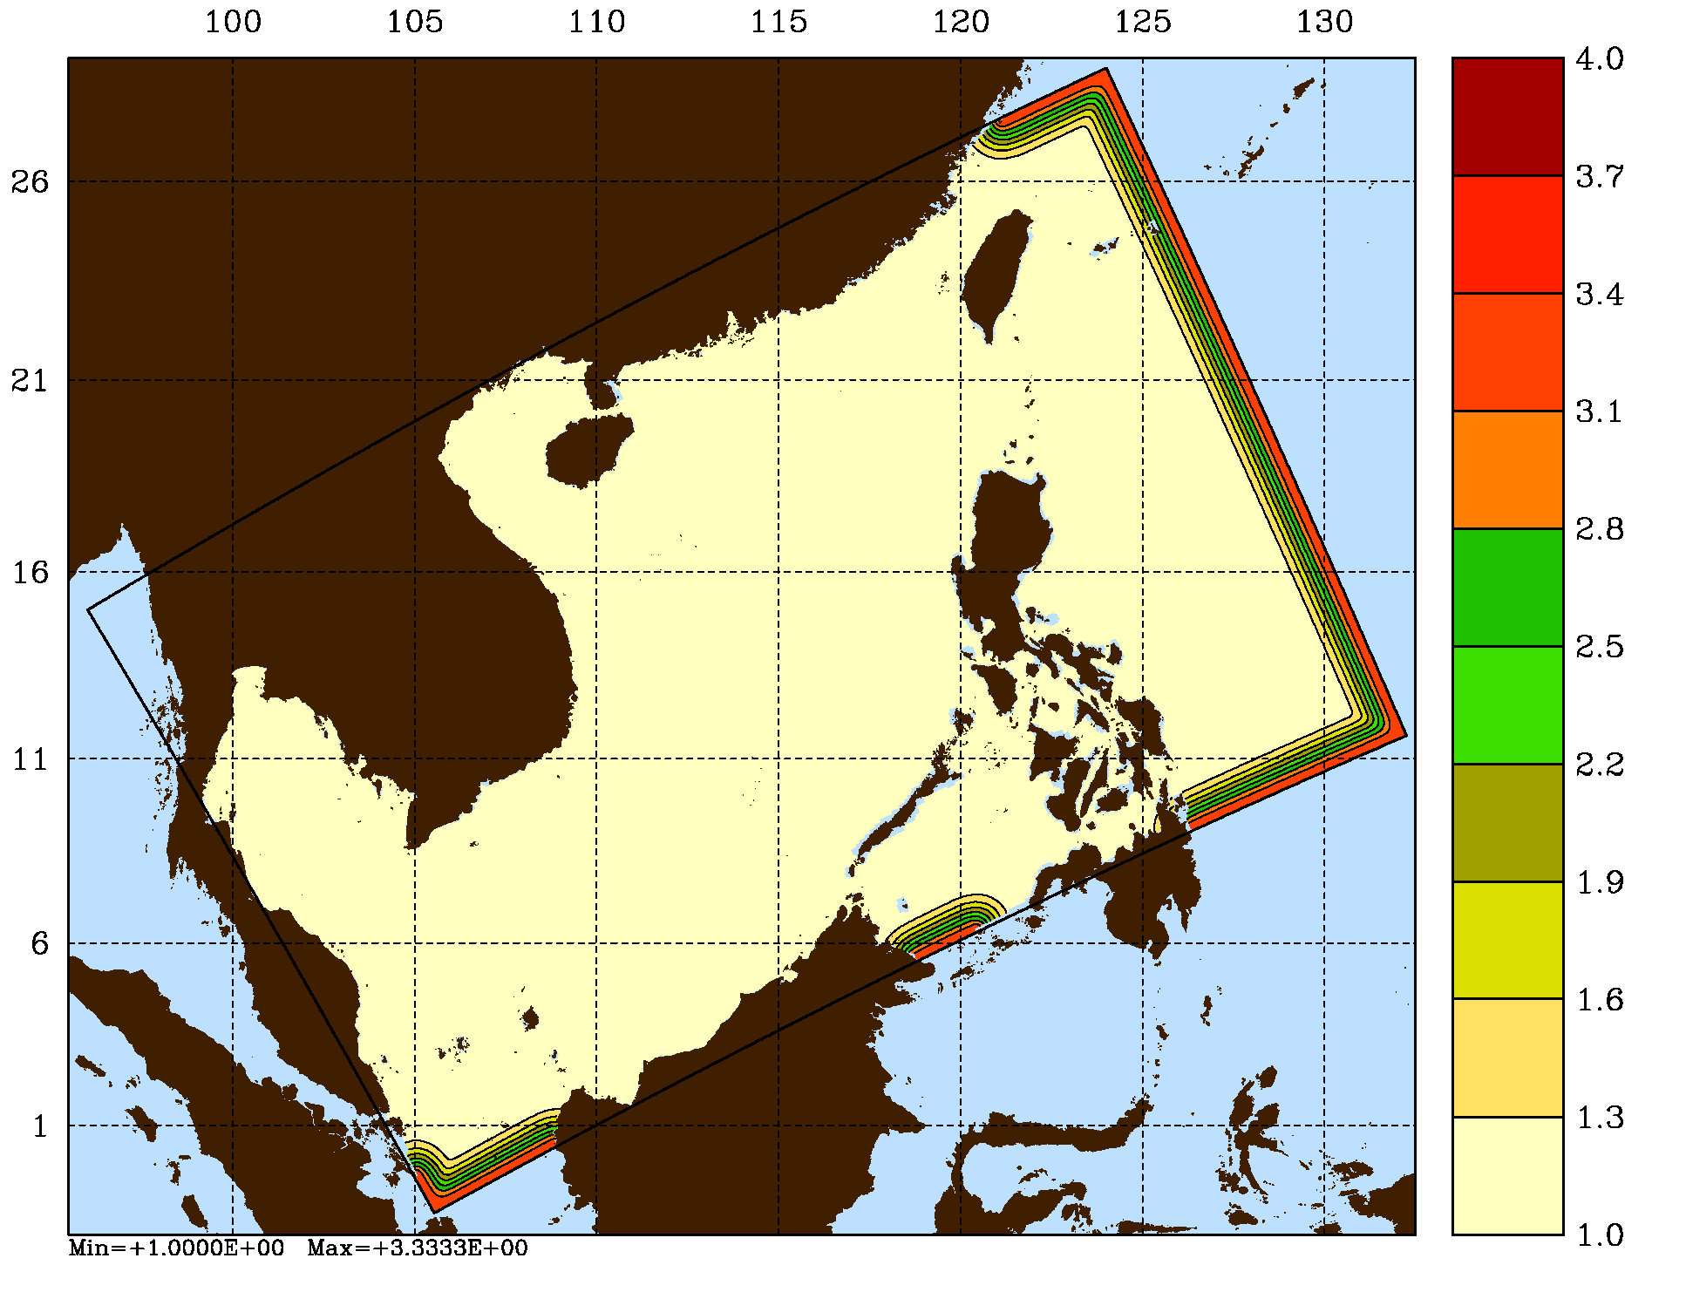
Viscosity and Diffusion Sponges
The horizontal viscosity is now computed as:
visc2_r(i,j) = visc_factor(i,j) * visc2_r(i,j)
visc4_r(i,j) = visc_factor(i,j) * visc4_r(i,j)
And the horizontal diffusion is now computed as:
diff2(i,j,itrc) = diff_factor(i,j) * diff2(i,j,itrc)
diff4(i,j,itrc) = diff_factor(i,j) * diff4(i,j,itrc)
The horizontal mixing coefficients (visc_factor and diff_factor) can be set with analytical functions using ANA_SPONGE or can be read from input GRID NetCDF file variables:
double visc_factor (eta_rho, xi_rho) ;
visc_factor:long_name = "horizontal viscosity sponge factor" ;
visc_factor:valid_min = 0. ;
visc_factor:coordinates = "lon_rho lat_rho" ;
double diff_factor (eta_rho, xi_rho) ;
diff_factor:long_name = "horizontal diffusivity sponge factor" ;
diff_factor:valid_min = 0. ;
diff_factor:coordinates = "lon_rho lat_rho" ;
The Matlab script add_sponge.m can be used to append sponge variables to the application GRID NetCDF file

Slide 17
Standard Input File: Climatology and Nudging
Logical switches (TRUE/FALSE) to read and process climatology fields. See glossary below for details.
LsshCLM == 3*F ! sea-surface height
Lm2CLM == 3*F ! 2D momentum
Lm3CLM == 3*F ! 3D momentum
LtracerCLM == 2*F 2*F 2*F ! temperature, salinity, inert
Logical switches (TRUE/FALSE) to nudge the desired climatology field(s). If not analytical climatology fields, users need to turn ON the logical switches above to process the fields from the climatology NetCDF file that are needed for nudging. See glossary below for details.
LnudgeM2CLM == 3*F ! 2D momentum
LnudgeM3CLM == 3*F ! 3D momentum
LnudgeTCLM == 2*F 2*F 2*F ! temperature, salinity, inert

Slide 18
Nudging Coefficients Metadata
The inverse (1/time) nudging coefficients can be set with analytical functions using ANA_NUDGCOEF or can be read from new input NUDNAME NetCDF file variables:
double M2_NudgeCoef (eta_rho, xi_rho) ;
M2_NudgeCoef:long_name = "2D momentum inverse nudging coefficients" ;
M2_NudgeCoef:units = "day-1" ;
M2_NudgeCoef:coordinates = "xi_rho eta_rho " ;
double M3_NudgeCoef (s_rho, eta_rho, xi_rho) ;
M3_NudgeCoef:long_name = "3D momentum inverse nudging coefficients" ;
M3_NudgeCoef:units = "day-1" ;
M3_NudgeCoef:coordinates = "xi_rho eta_rho s_rho " ;
double tracer_NudgeCoef (s_rho, eta_rho, xi_rho) ;
tracer_NudgeCoef:long_name = "generic tracer inverse nudging coefficients” ;
tracer_NudgeCoef:units = "day-1" ;
tracer_NudgeCoef:coordinates = "xi_rho eta_rho s_rho " ;
double temp_NudgeCoef (s_rho, eta_rho, xi_rho) ;
temp_NudgeCoef:long_name = "temp inverse nudging coefficients" ;
temp_NudgeCoef:units = "day-1" ;
temp_NudgeCoef:coordinates = "xi_rho eta_rho s_rho " ;
double salt_NudgeCoef (s_rho, eta_rho, xi_rho) ;
salt_NudgeCoef:long_name = "salt inverse nudging coefficients" ;
salt_NudgeCoef:units = "day-1" ;
salt_NudgeCoef:coordinates = "xi_rho eta_rho s_rho " ;

Slide 19
Contact Regions and Contact Points

Slide 20
Contact Points Interpolation
Suffix: dg = donor grid
rg = receiver grid
8
7 Kdg
4
3 (Idg+1, Jdg+1, Kdg-1)
5
6
1- q
p
5
Jrg
1- p
q
4
3 Kdg-1
(Idg, Jdg, Kdg-1) 1
Irg
2
1
2
Lweight (1, :) = (1 - p) * (1 - q)
Lweight (2, :) = p * (1 - q)
Lweight (3, :) = p * q
Lweight (4, :) = (1 - p) * q
Value (Irg, Jrg) = Lweight (1,:) * F2d(Idg ,Jdg )+
Lweight (2,:) * F2d(Idg+1,Jdg )+
Lweight (3,:) * F2d(Idg+1,Jdg+1)+
Lweight (4,:) * F2d(Idg ,Jdg+1)
If coincident contact points between data donor and data receiver grids, p = q = 0.0,
Lweight (1, :) = 1.0 Value (Irg, Jrg) = Lweight (1, :) * F2d( Idg, Jdg )
Lweight (3, :) = 0.0
Lweight (4, :) = 0.0
Lweight (5, :) = 0.0

Slide 21
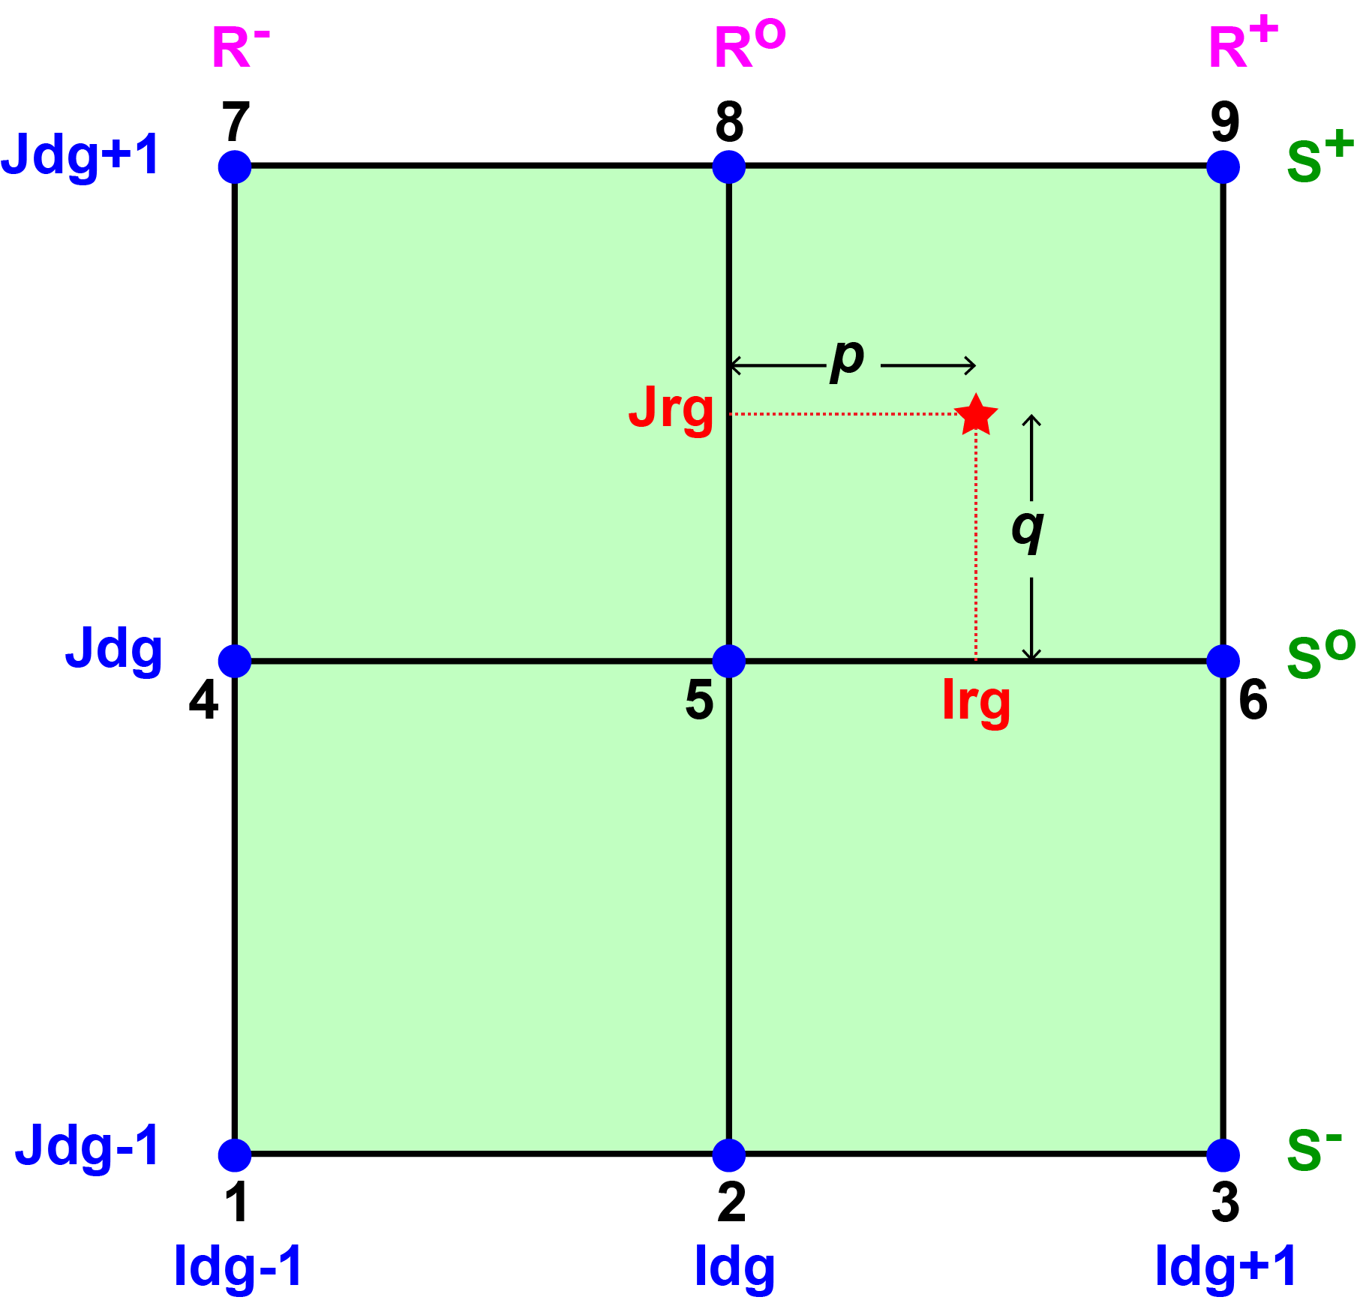
Contact Points: Quadratic Interpolation
R⁻ = 0.5 * p * (p-1) + α
Rº = (1-p²) - 2α
R⁺ = 0.5 * p * (p+1) + α
S⁻ = 0.5 * q * (q-1) + α
Sº = (1-q²) - 2α
S⁺ = 0.5 * q * (q+1) + α
The finer grid variable, F, is interpolated from the coarser grid variable, C, as:
F(Irg,Jrg) = S⁻ * [R⁻ * C(Idg-1,Jdg-1) + Rº * C(Idg,Jdg-1) + R⁺ * C(Idg+1,Jdg-1)]+
Sº * [R⁻ * C(Idg-1,Jdg ) + Rº * C(Idg,Jdg ) + R⁺ * C(Idg+1,Jdg )]+
S⁺ * [R⁻ * C(Idg-1,Jdg+1) + Rº * C(Idg,Jdg+1) + R⁺ * C(Idg+1,Jdg+1)]

Slide 22
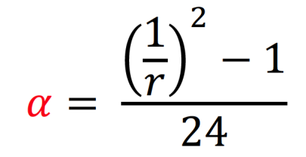
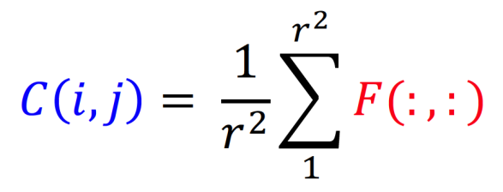
Contact Points: Quadratic Interpolation
For conservation and reversibility, we need:
where r is the grid refinement factor. The reversibility condition is:
Then, the quadratic interpolation weights are:
Qweight (1, :) = R⁻ * S⁻
Qweight (2, :) = Rº * S⁻
Qweight (3, :) = R⁺ * S⁻
Qweight (4, :) = R⁻ * Sº
Qweight (5, :) = Rº * Sº
Qweight (6, :) = R⁺ * Sº
Qweight (7, :) = R⁻ * S⁺
Qweight (8, :) = Rº * S⁺
Qweight (9, :) = R⁺ * S⁺
Σ Qweight(1:9,:) = 1
Clark and Farley, 1984

Slide 23
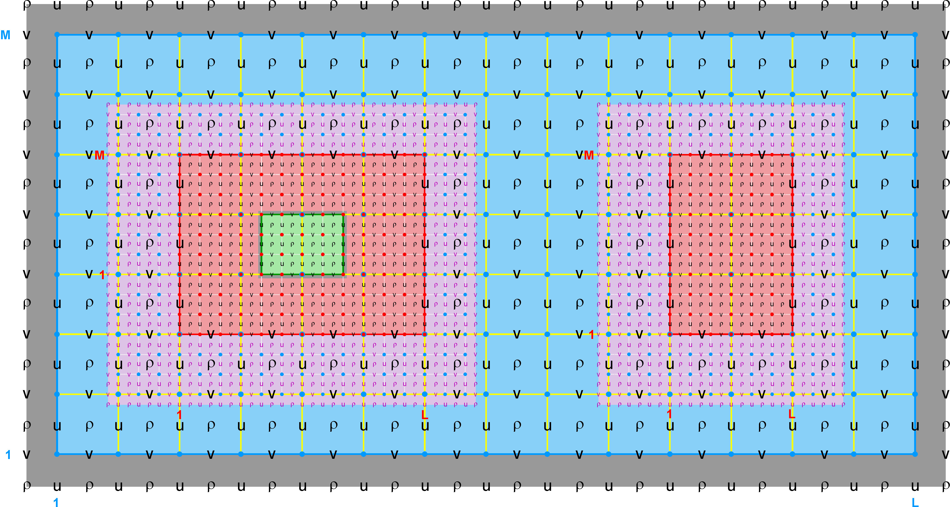
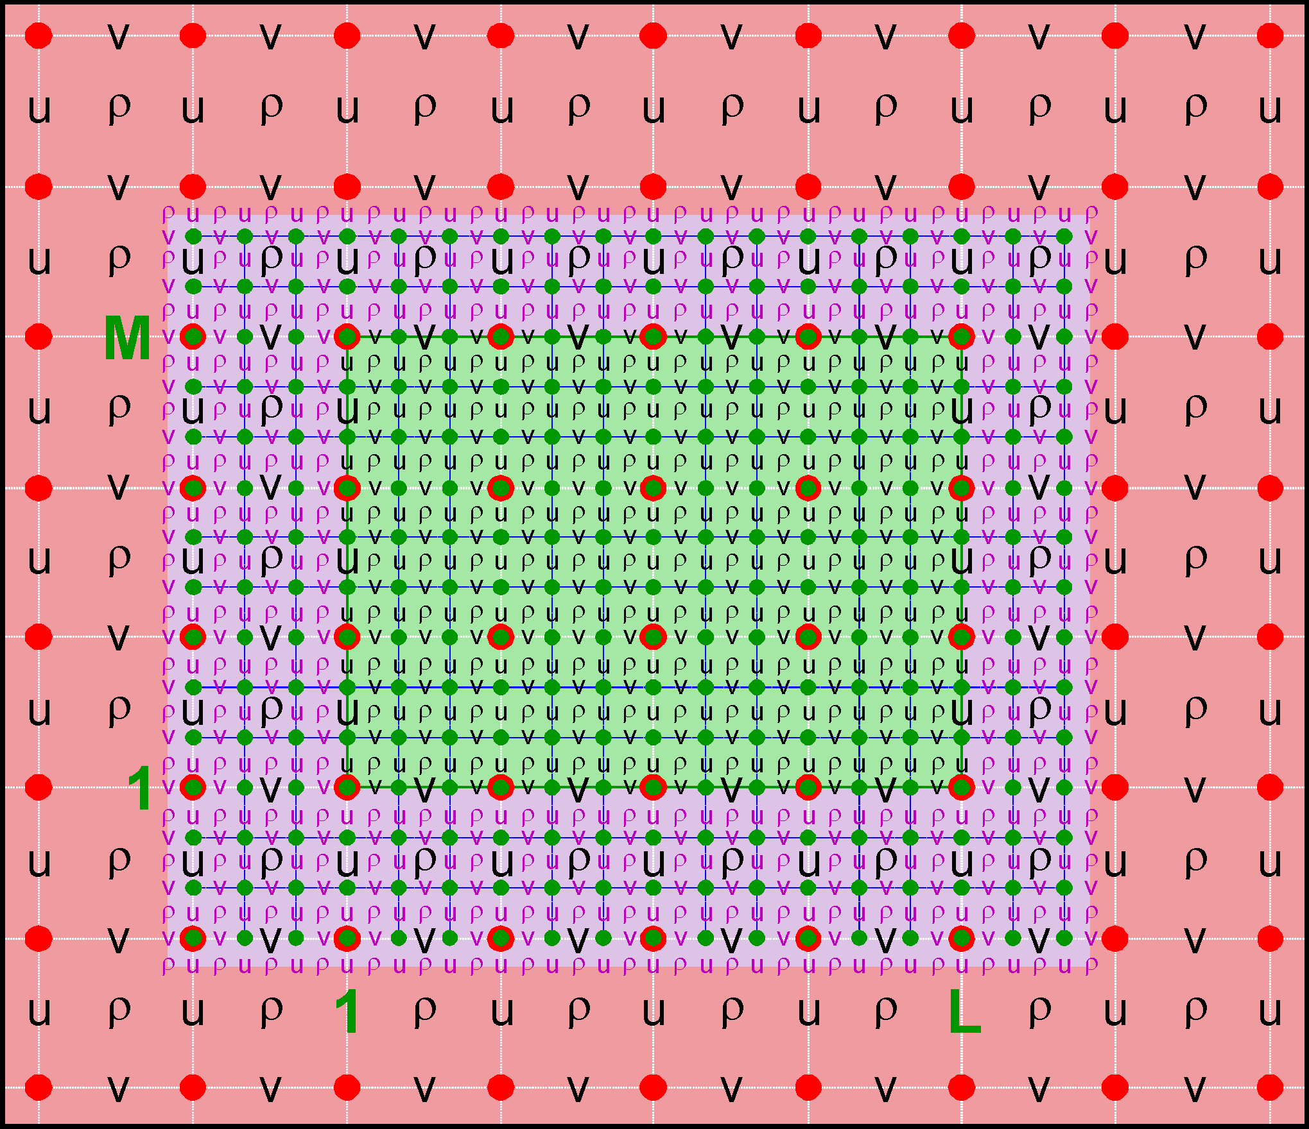
Nested Grids: Multi-Refinement Class
Ngrids = 4
NestLayers = 3
GridsInLayer = 1 2 1
Ncontact = 6
Donor Grid = blue
Receiver Grid = red
Ngrids = 4
NestLayers = 3
GridsInLayer = 1 2 1
Ncontact = 6
Donor Grid = red
Receiver Grid = green

Slide 24
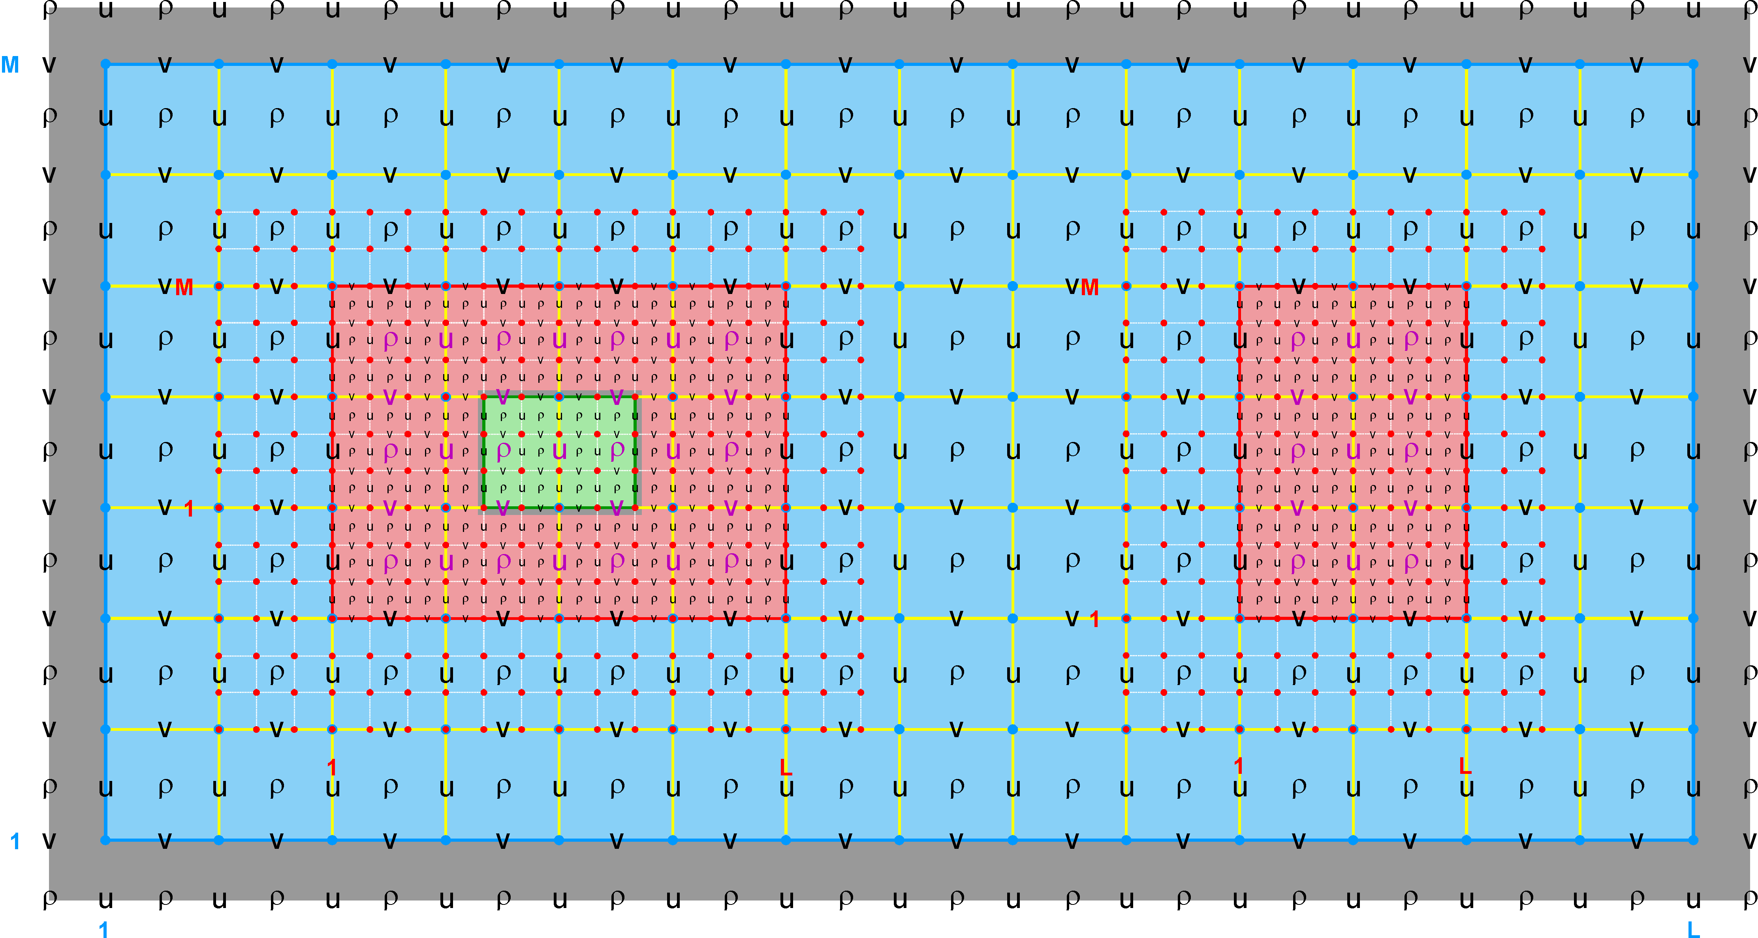
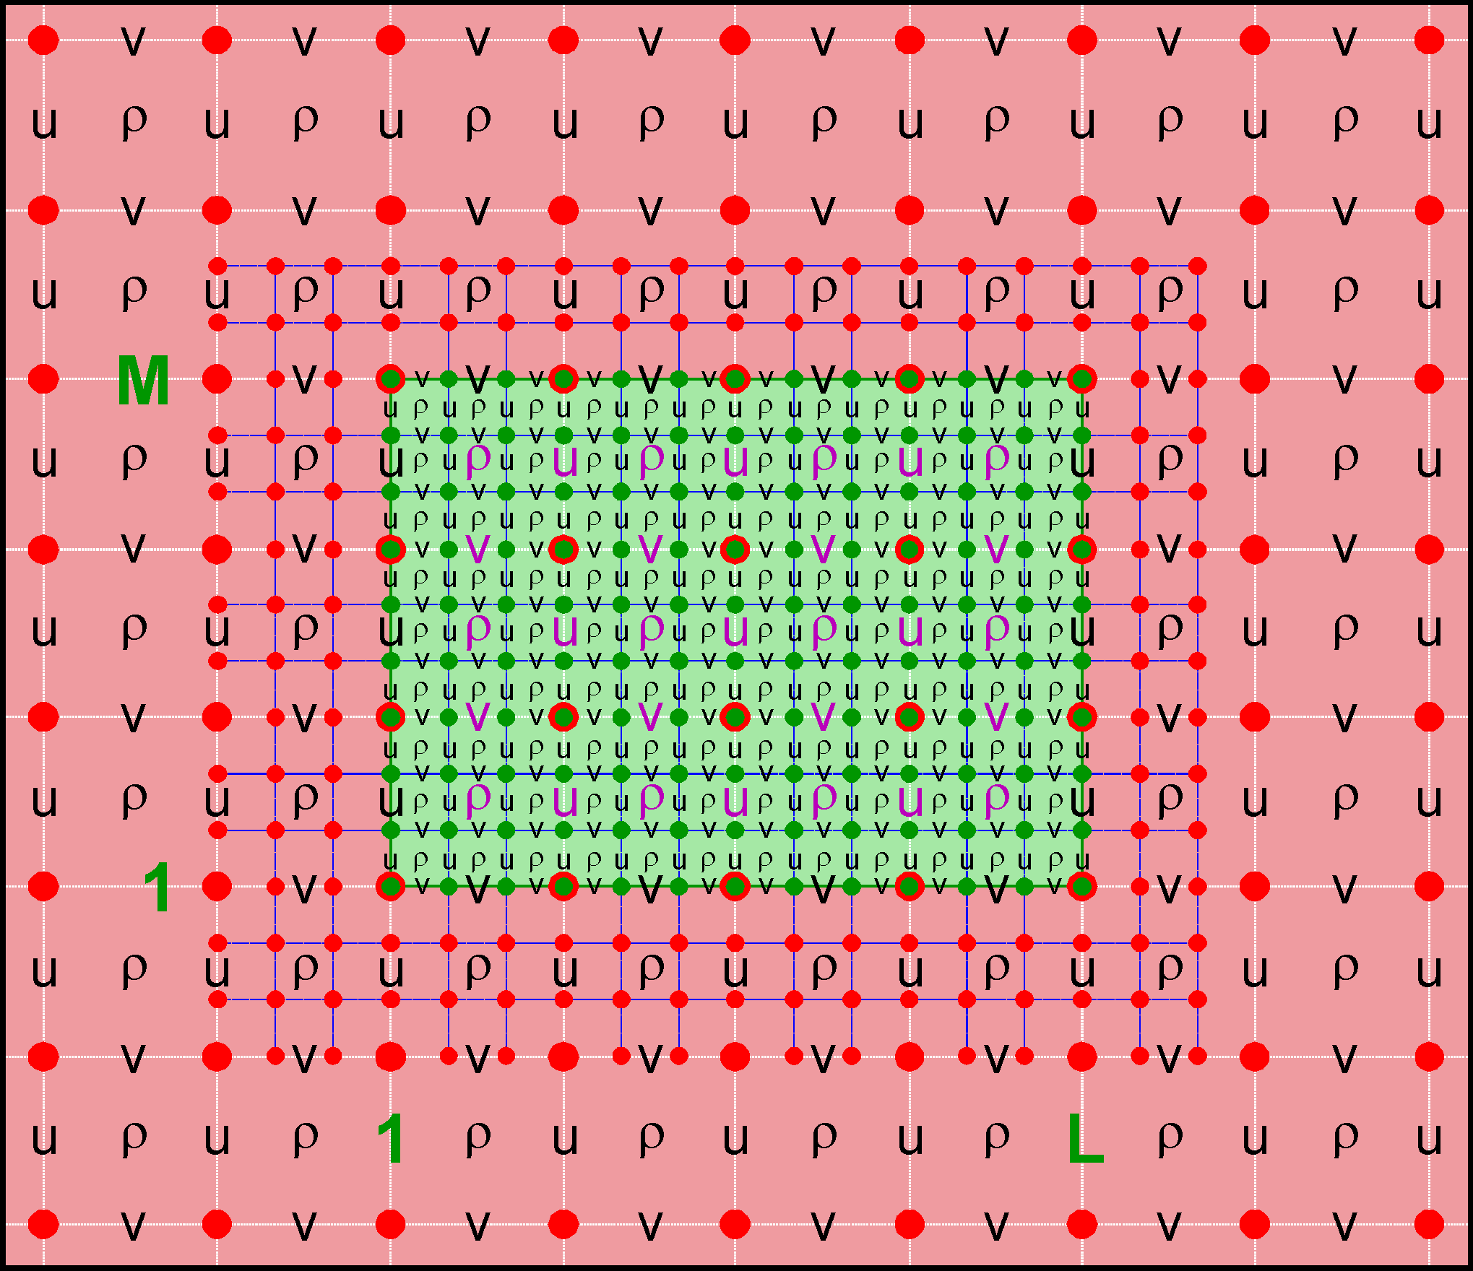
Nested Grids: Multi-Refinement Class
Ngrids = 4
NestLayers = 3
GridsInLayer = 1 2 1
Ncontact = 6
Donor Grid = red
Receiver Grid = blue
Ngrids = 4
NestLayers = 3
GridsInLayer = 1 2 1
Ncontact = 6
Donor Grid = green
Receiver Grid = red

Slide 25
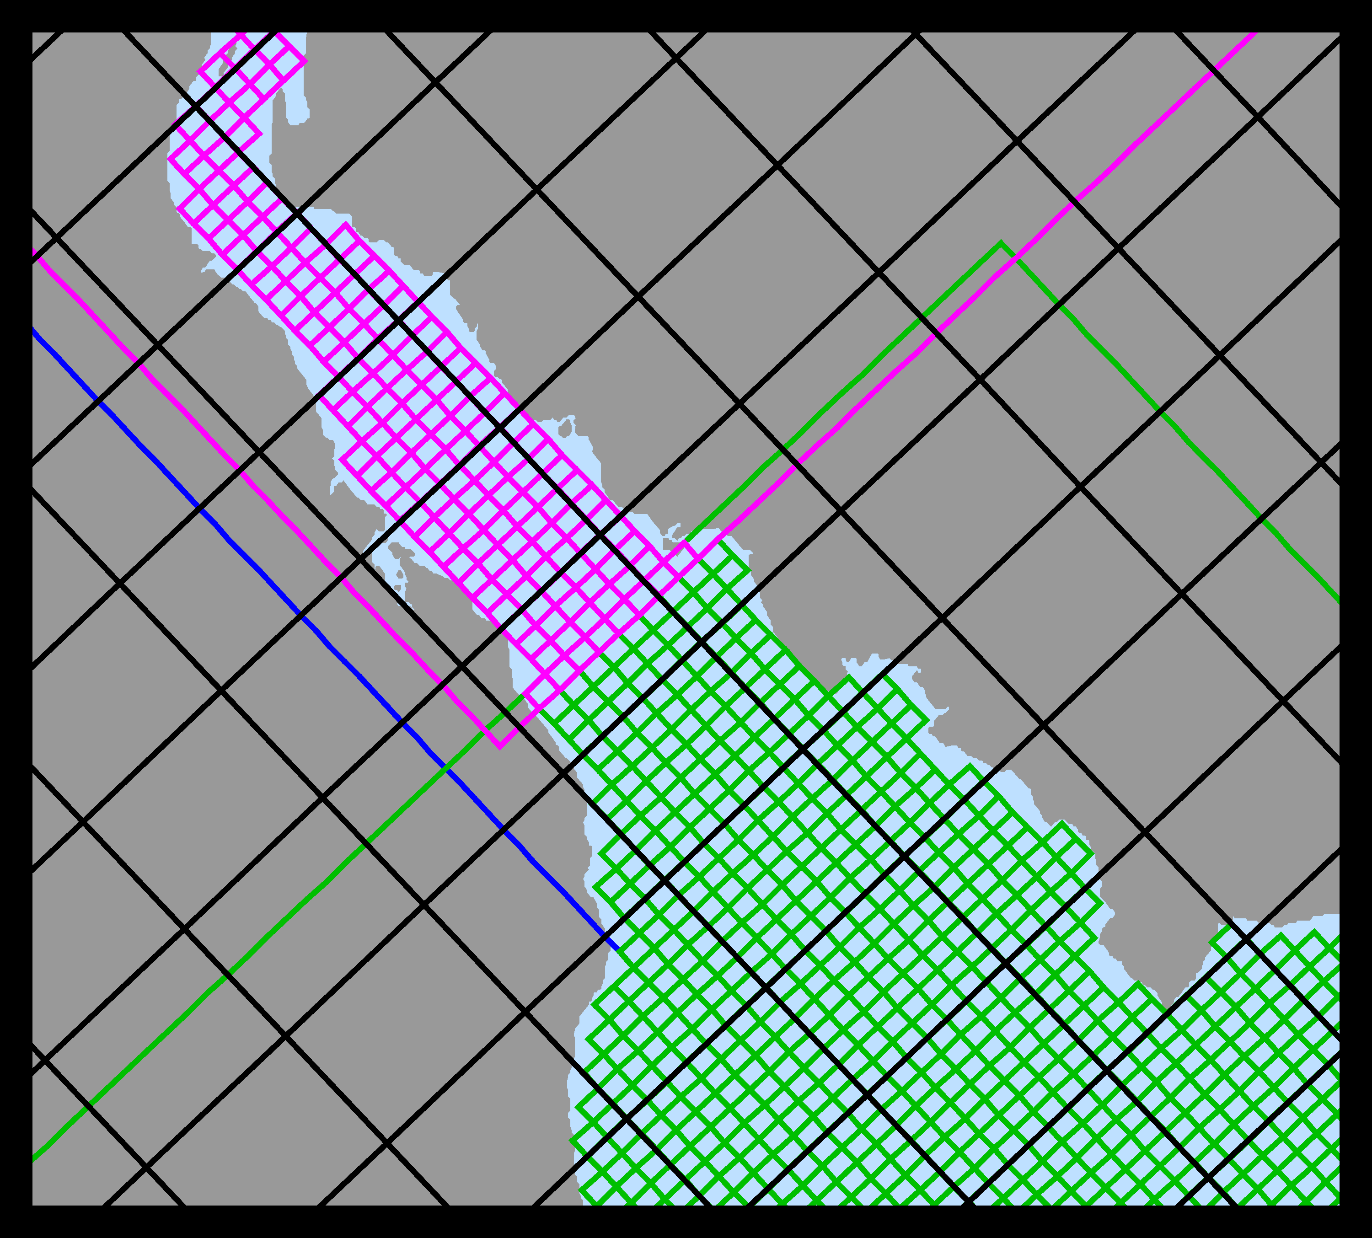
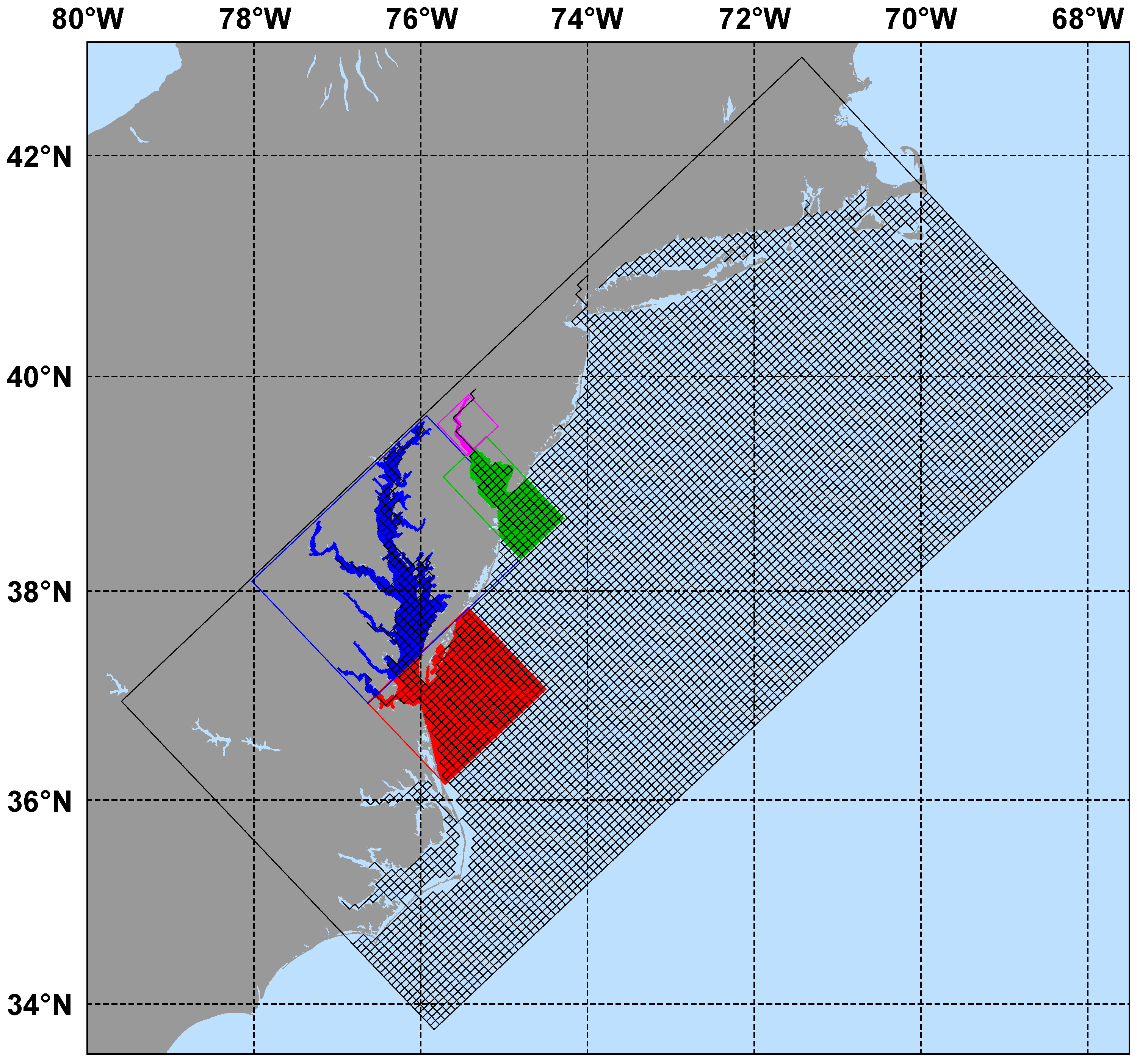
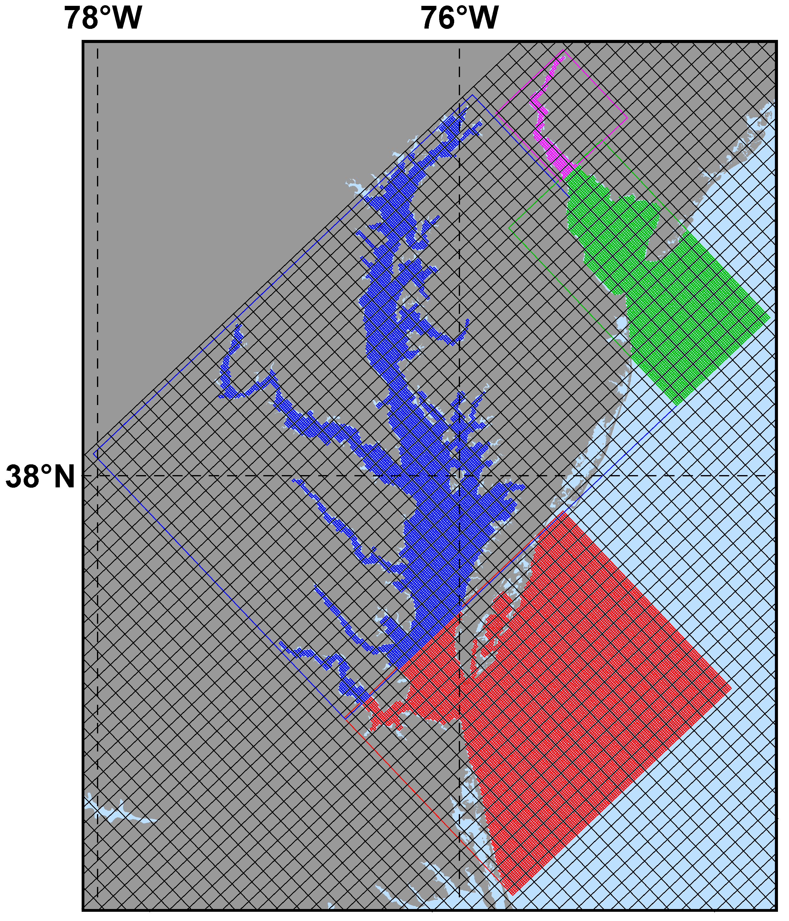
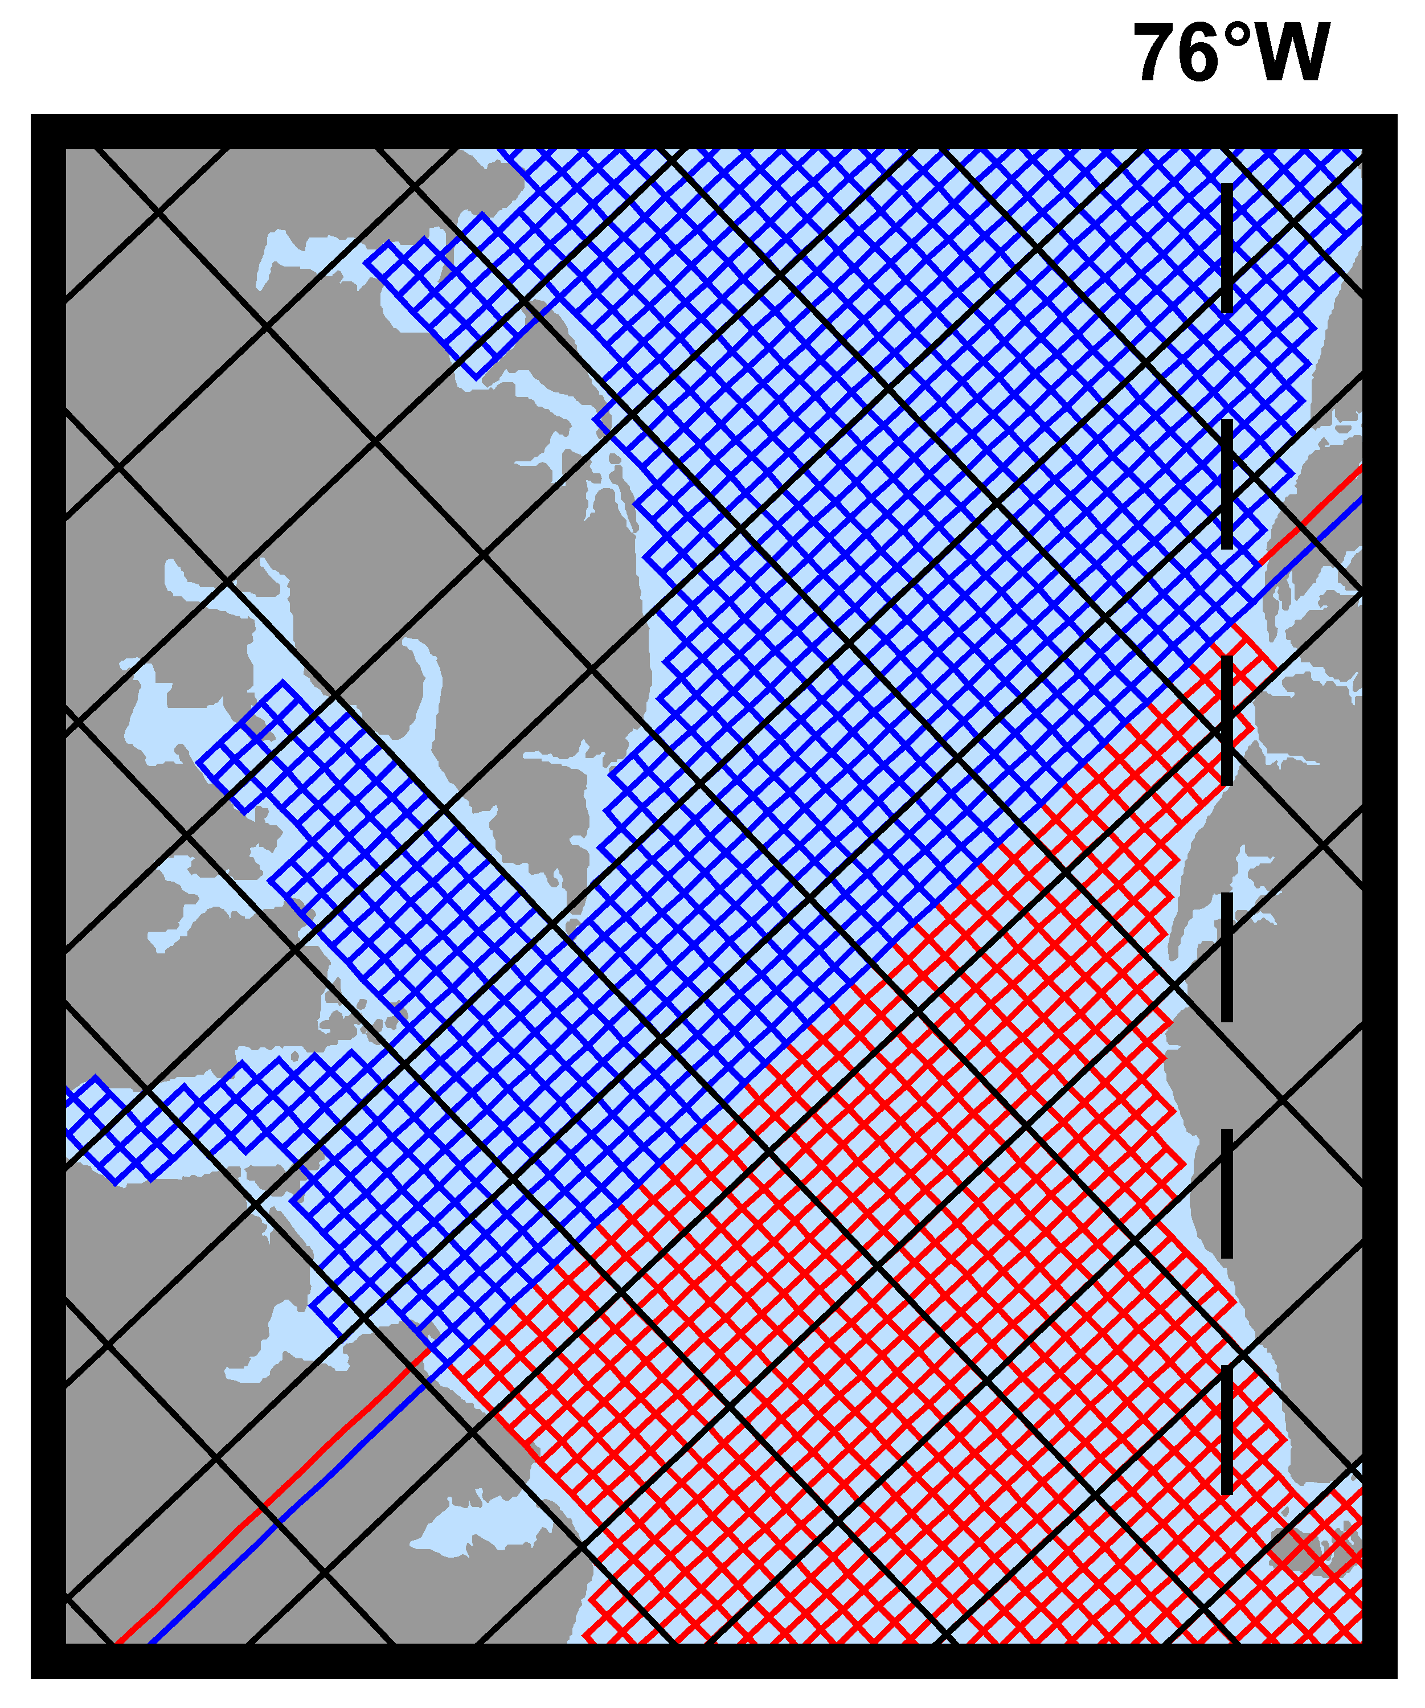
Realistic Nesting Configuration: US East Coast
(Complex Estuary Refinement-Composite Sub-Class)

Slide 26
Realistic Nesting Configuration: US East Coast
(Complex Estuary Refinement-Composite Sub-Class)
The coarser grid, ESPRESSO (130 x 82), has an average resolution of dx=7.5km, dy=5.8km. The nested grids (ρ-points mesh) are color coded for convenience to show the strategy used to better resolve the Delaware and Chesapeake Estuary Systems. The red and green are refinement grids whereas blue and magenta are composite grids. The refinement ratio is 1:7. An intermediate 1:7 refinement grid is created using Matlab script coarse2fine.m that included both the Delaware and Chesapeake Estuary Systems. Then, the Matlab script grid_extract.m is used to extract the Delaware Bay refinement grid (58 x 142) and Delaware River composite grid (42 x 55). Similarly, grid_extract.m is used to extract the Chesapeake Bay outer refinement grid (135 x 142) and Chesapeake Bay inner composite grid (233 x 212).

Slide 27
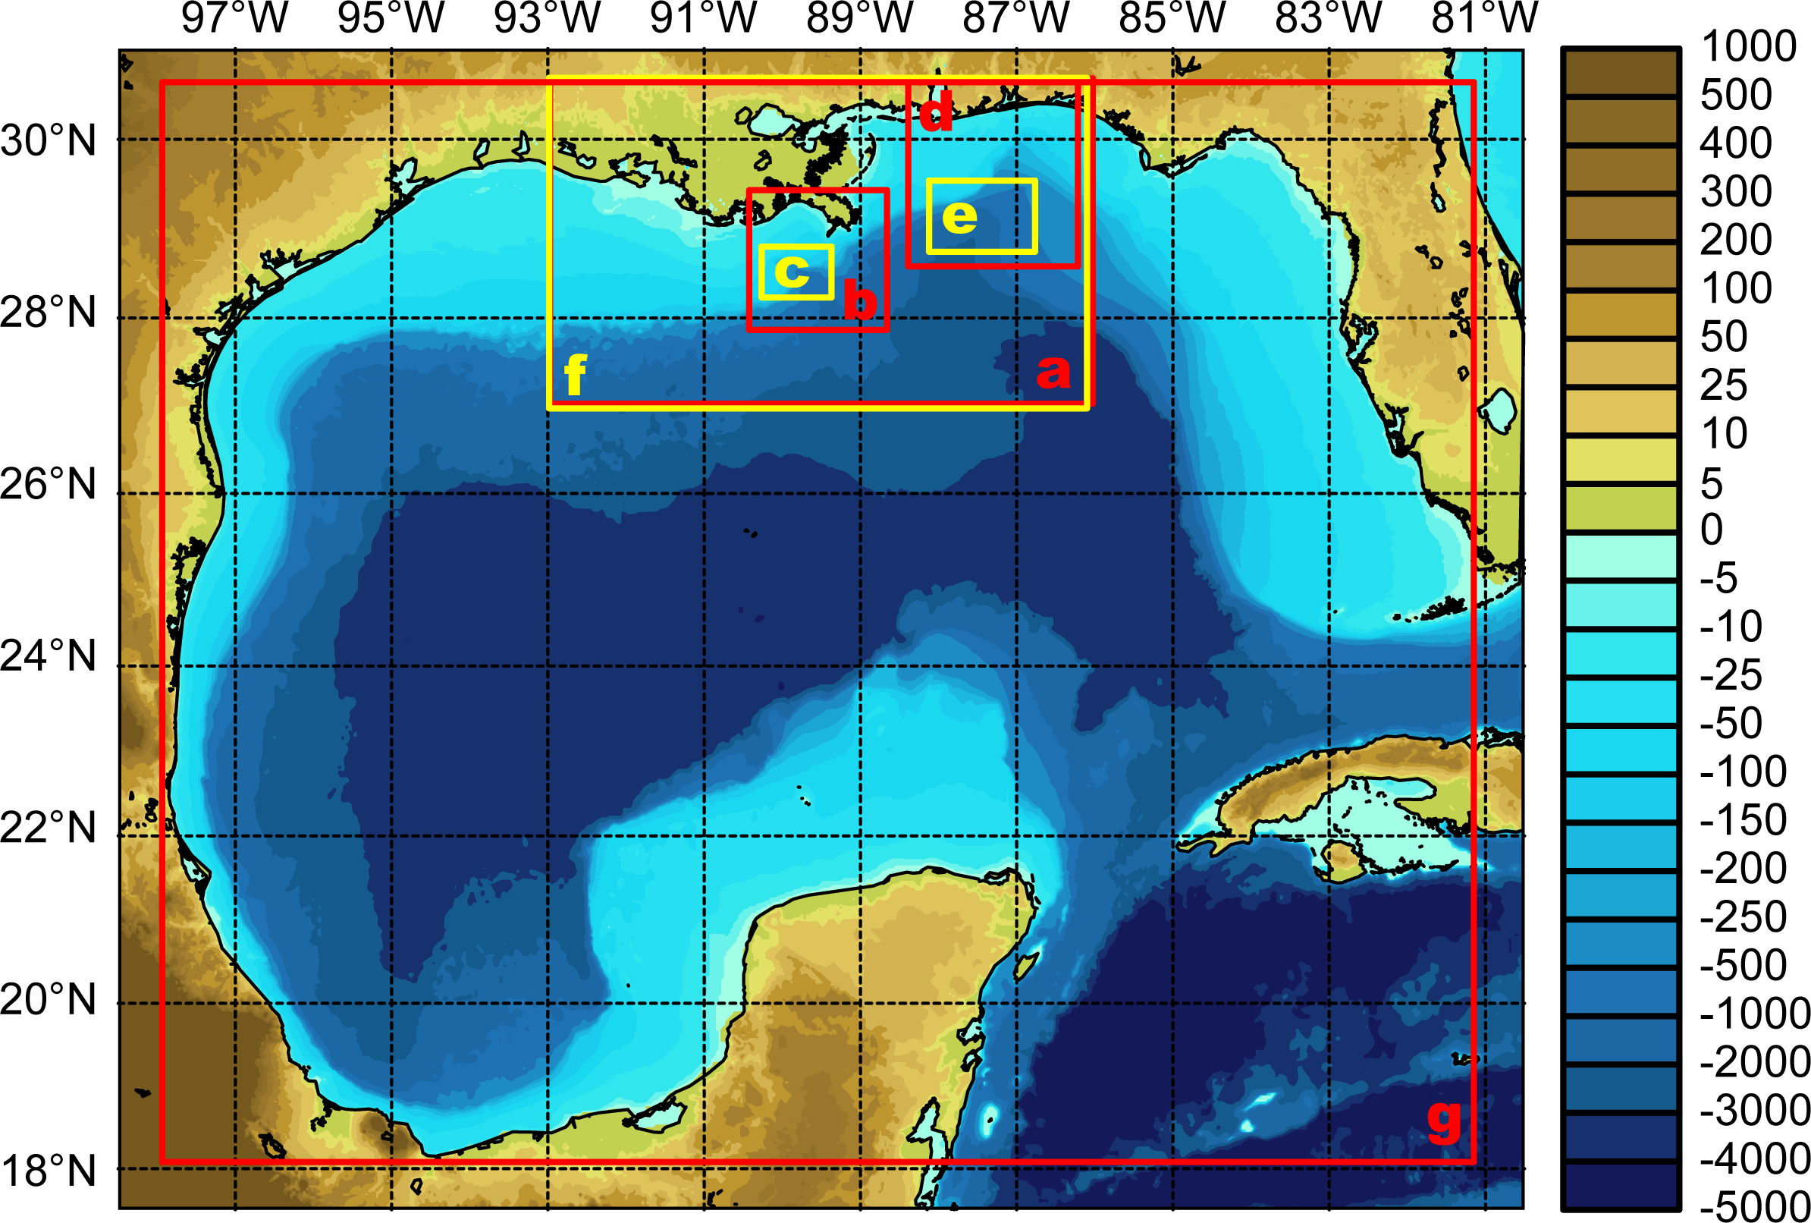
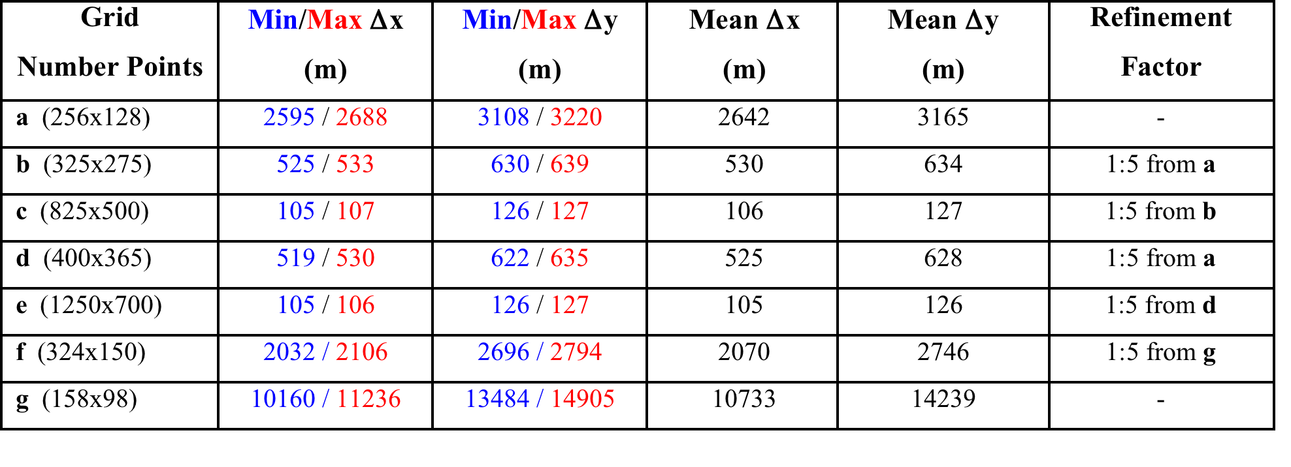
Realistic Nesting Configuration: Gulf of Mexico
(Multiple Refinement Sub-Class)

Slide 28
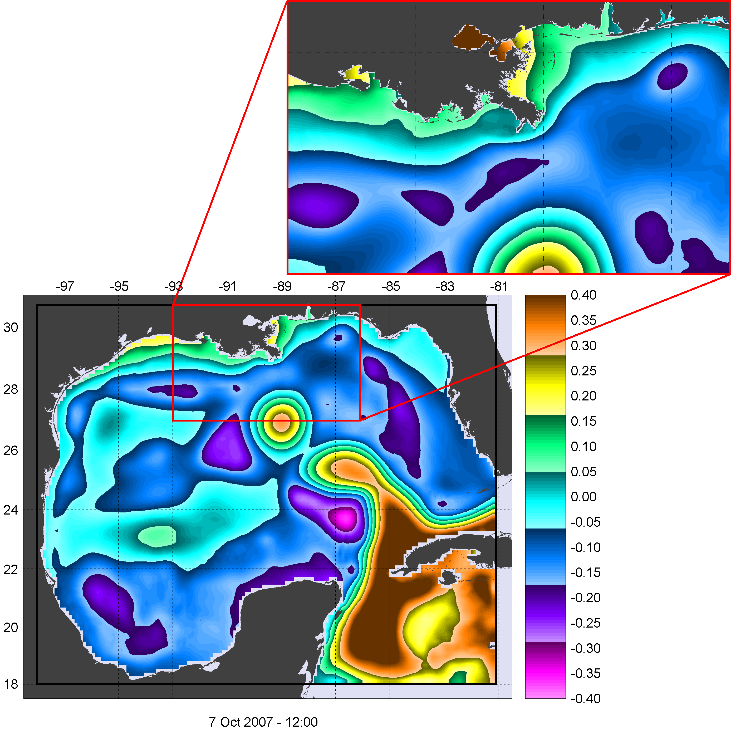
Realistic Nesting Configuration: Gulf of Mexico
(Multiple Refinement Sub-Class)

Slide 29
Realistic Nesting Configuration: US West Coast
(Telescoping Refinement Sub-Class)
Modeling of Monterey Canyon

Slide 30
Realistic Nesting Configuration: South China Sea
(Multiple Refinement Sub-Class)
Free-Surface

Slide 31
Realistic Nesting Configuration: South China Sea
(Multiple Refinement Sub-Class)
Temperature

Slide 32
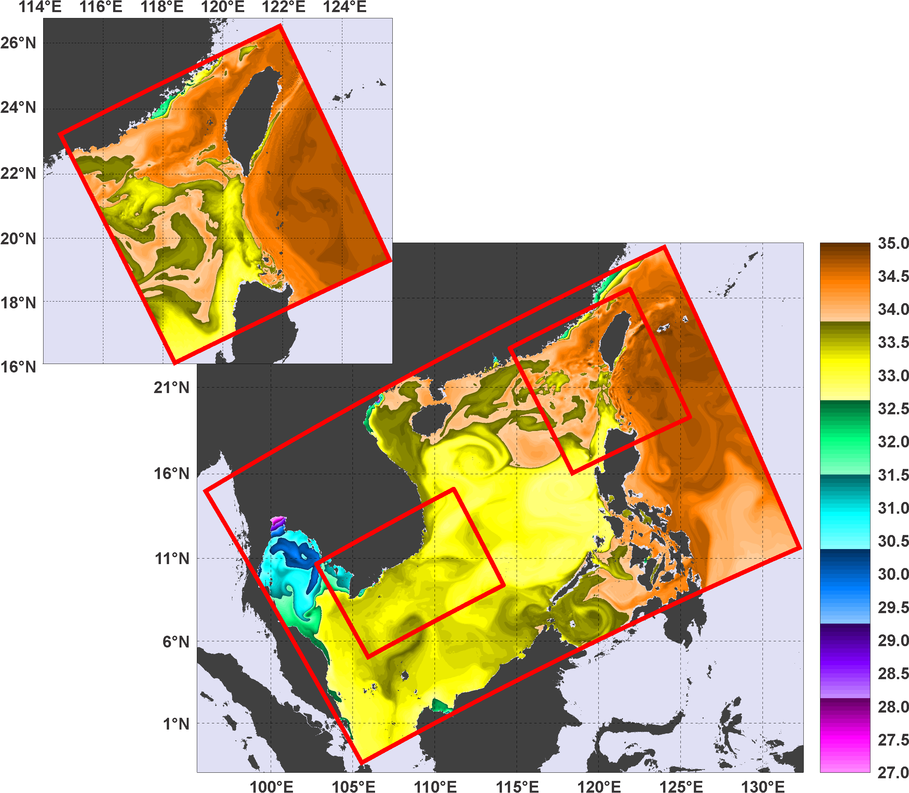
Realistic Nesting Configuration: South China Sea
(Multiple Refinement Sub-Class)
Salinity

Slide 33
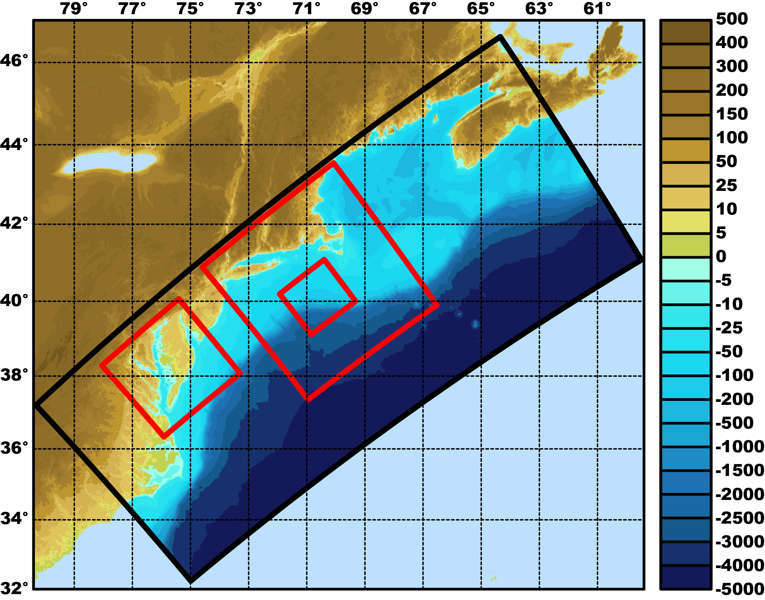
DOPPIO Refinement Grids
Bathymetry (m)

Slide 34
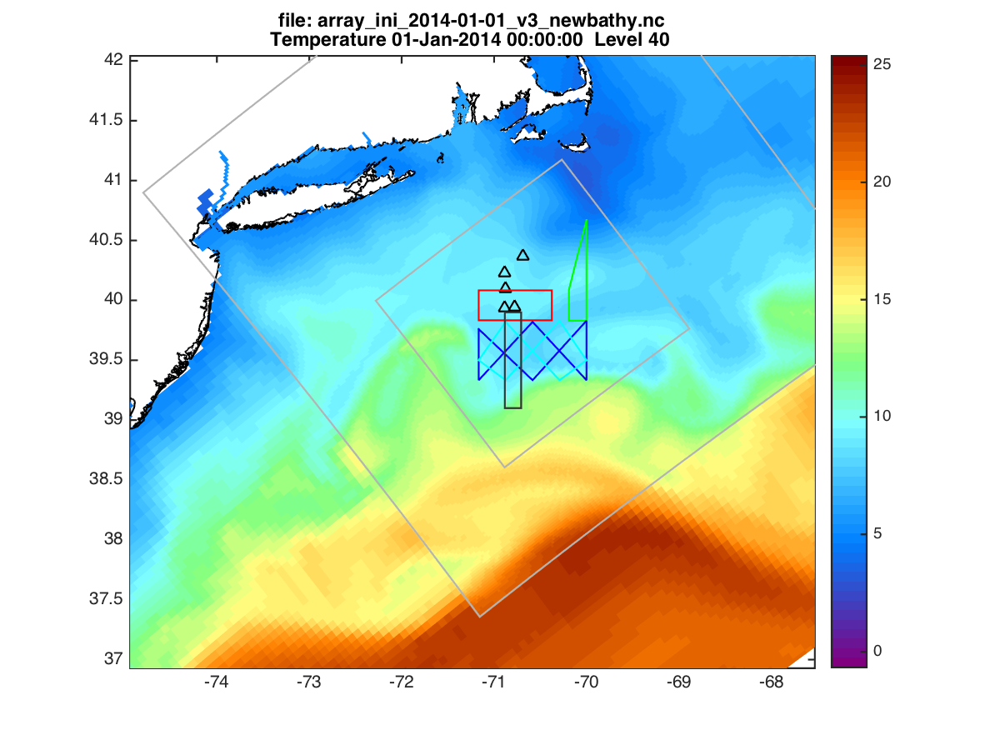
PIONEER Data Array Observations
Initial Surface Temperature (01-Jan-2014)

Slide 35
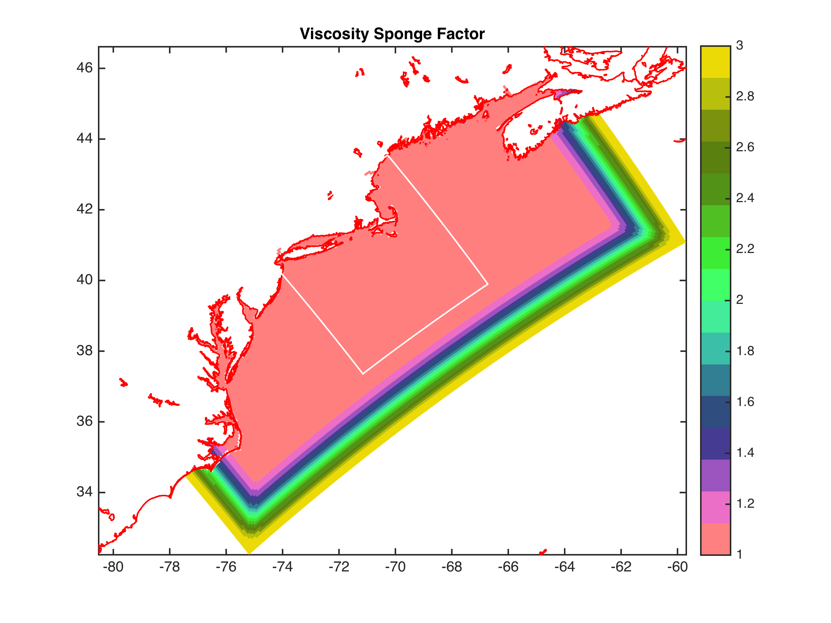

DOPPIO Sponge Areas
Same Reynolds Number for all Grids (U Δx/ν):
VISC2 == 90.0d0 30.0d0 10.0d0 (m2/s) TNU2 == 2*27.0d0 2*9.0d0 2*3.0d0 (m2/s)
Time stepping (Δt):
DT == 180.0d0 90.0d0 45.0d0 (3/1.5/0.75 minute step)

Slide 36
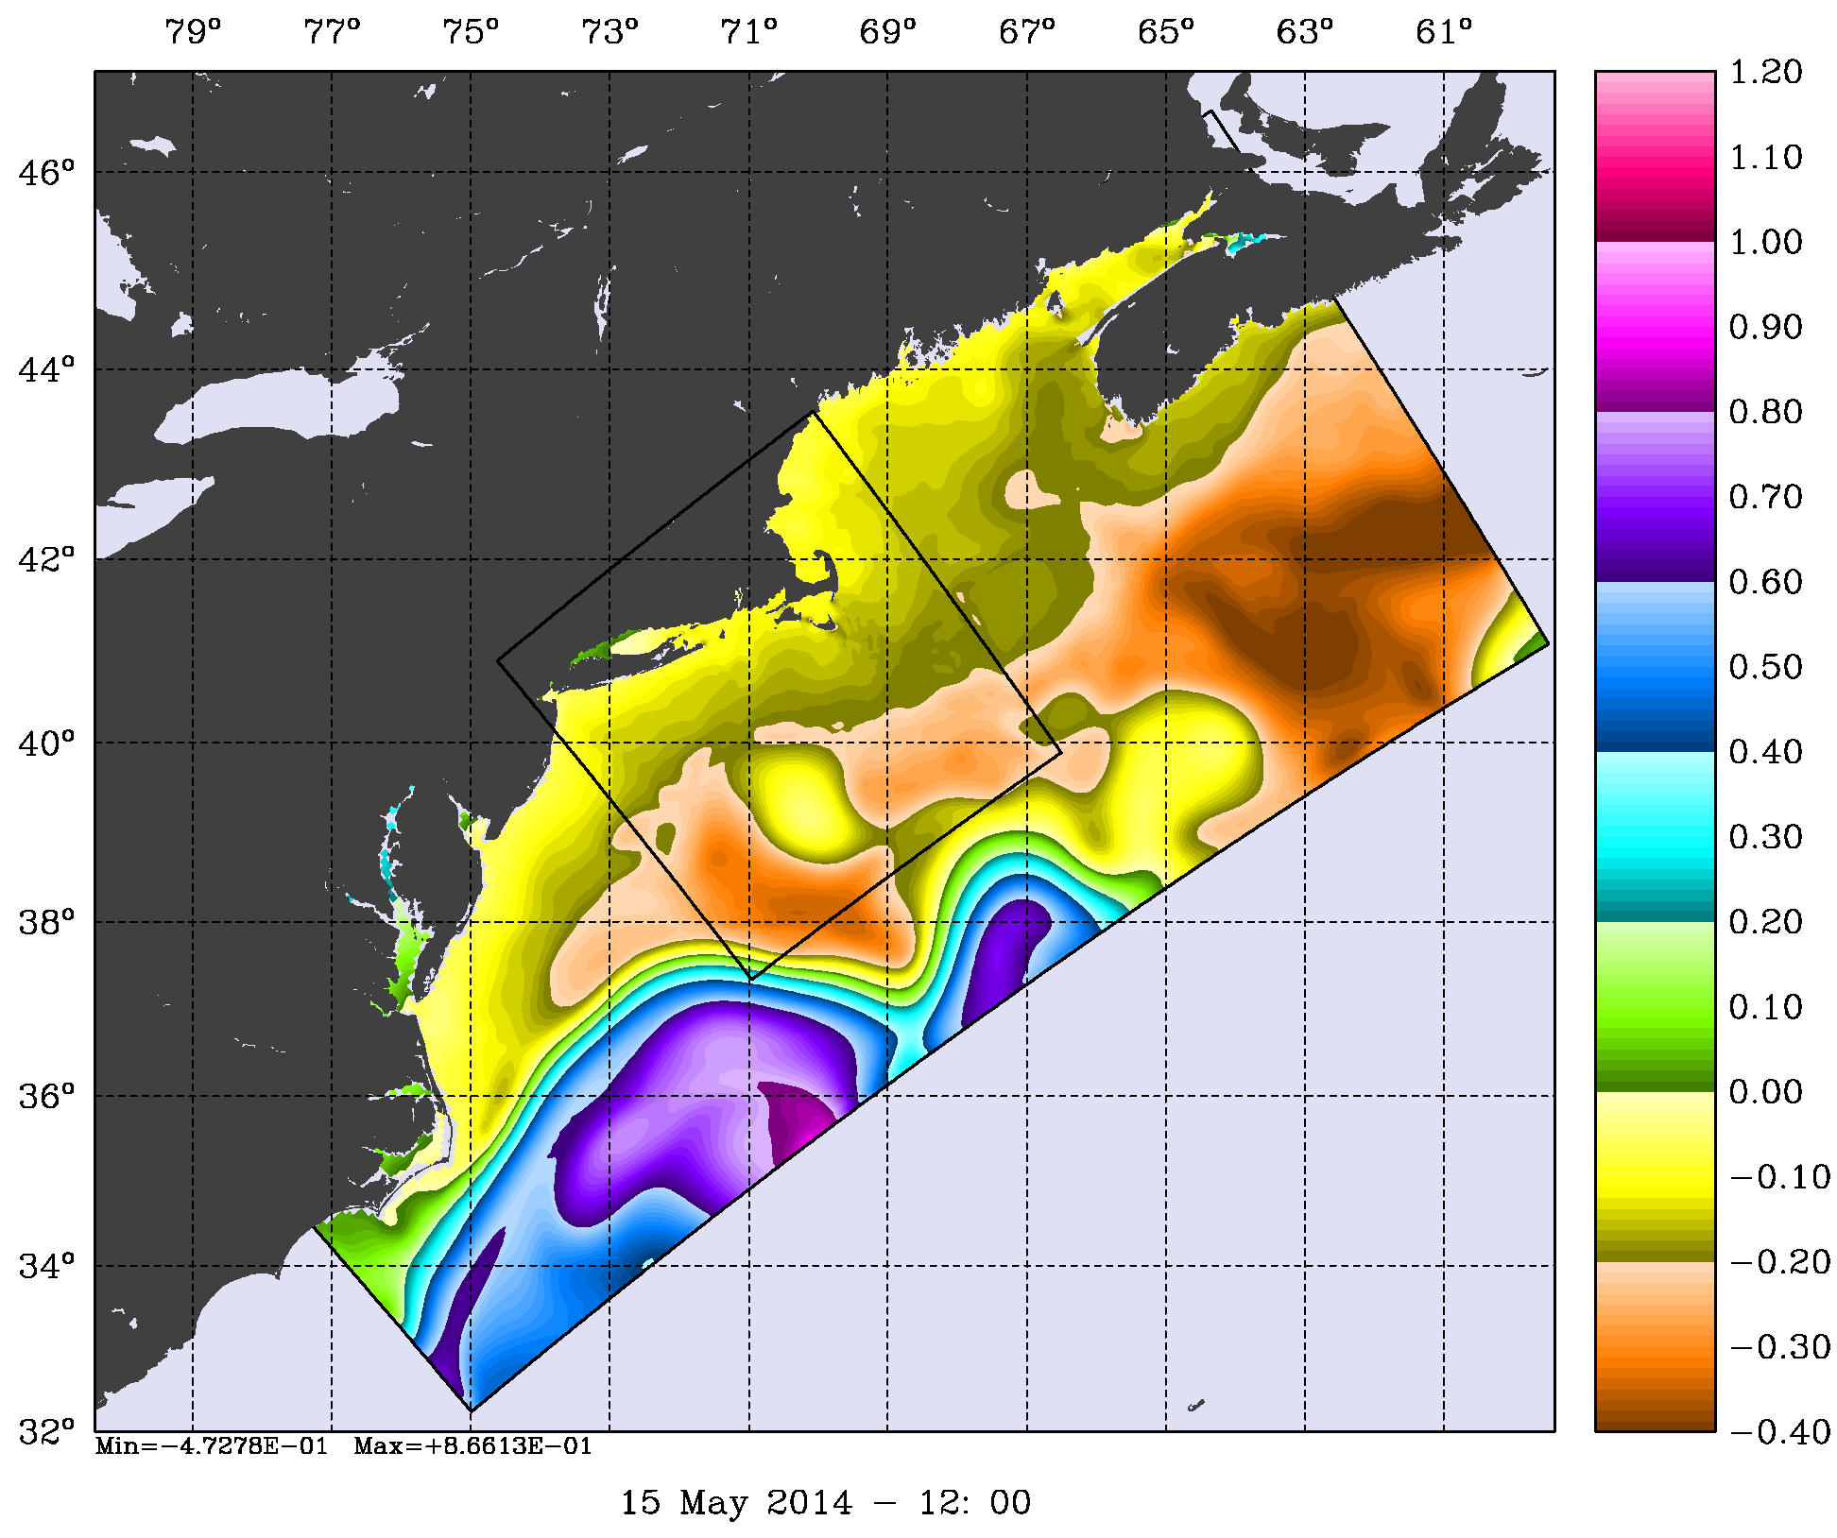
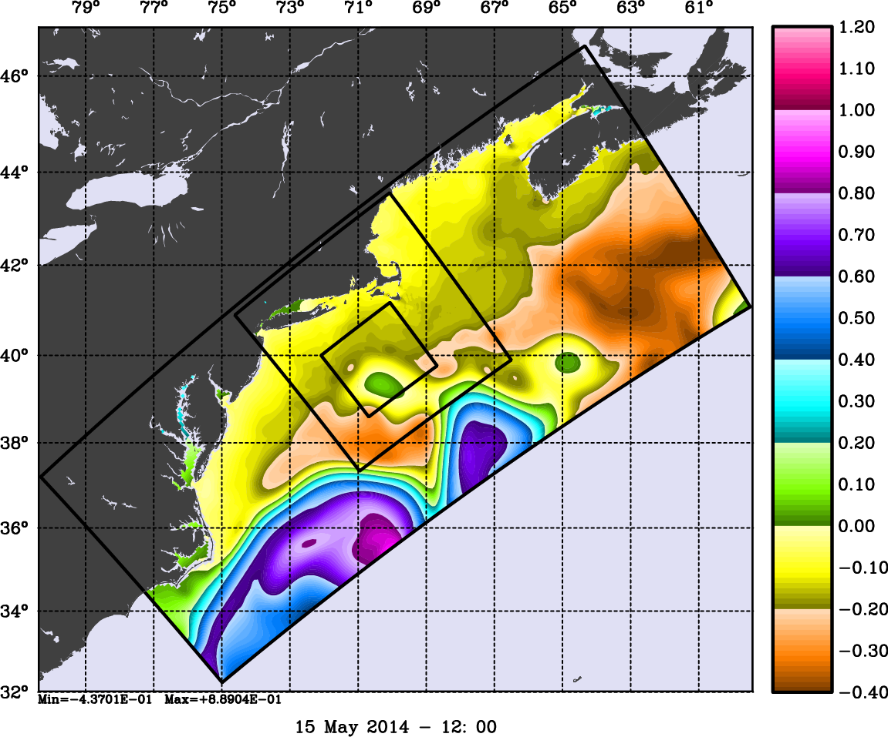
Two-Way DOPPIO-PIONEER-ARRAY
(1:3 Refinement)
Free-Surface

Slide 37
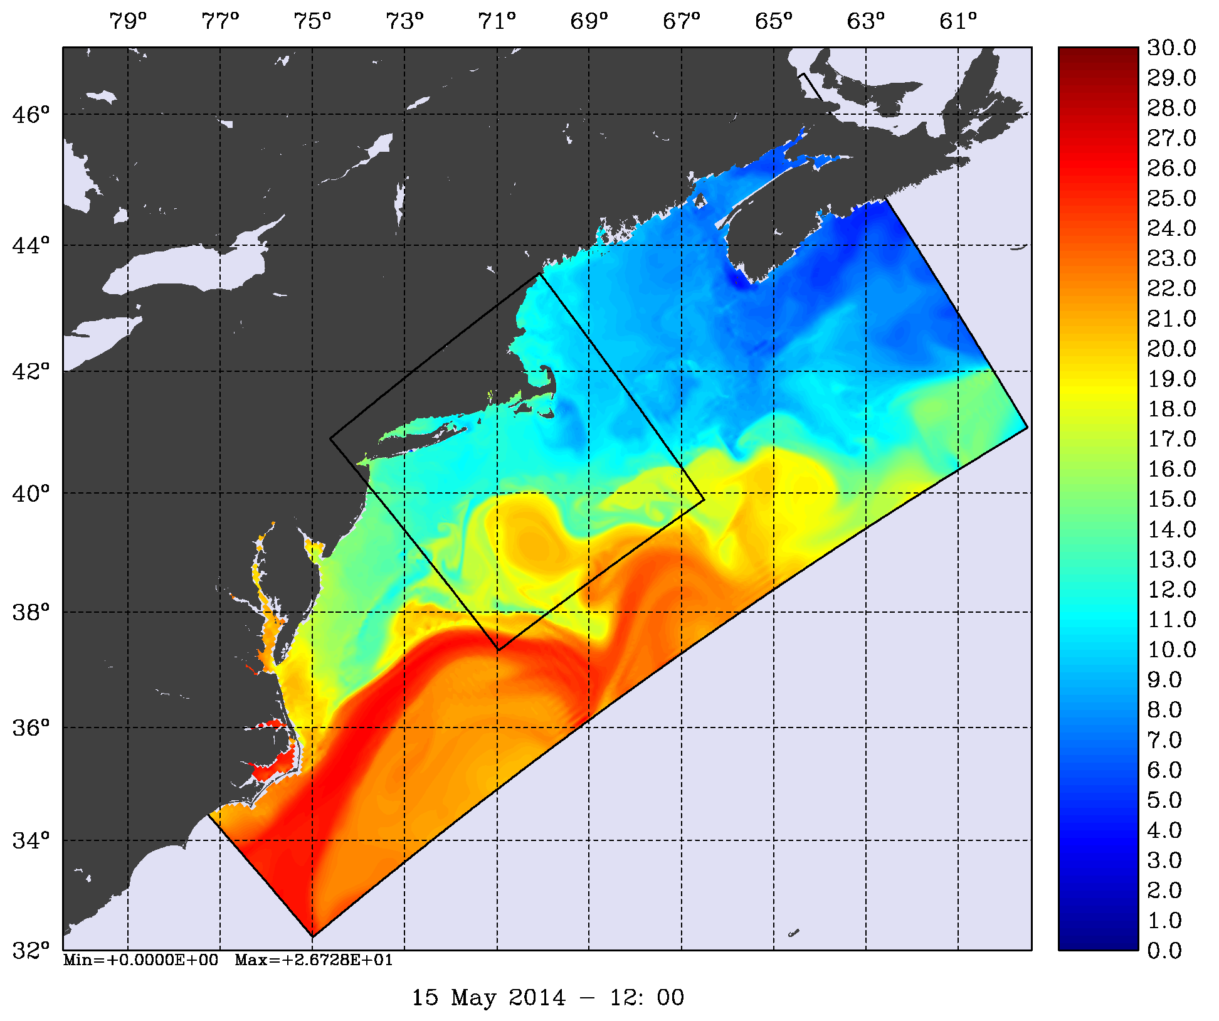
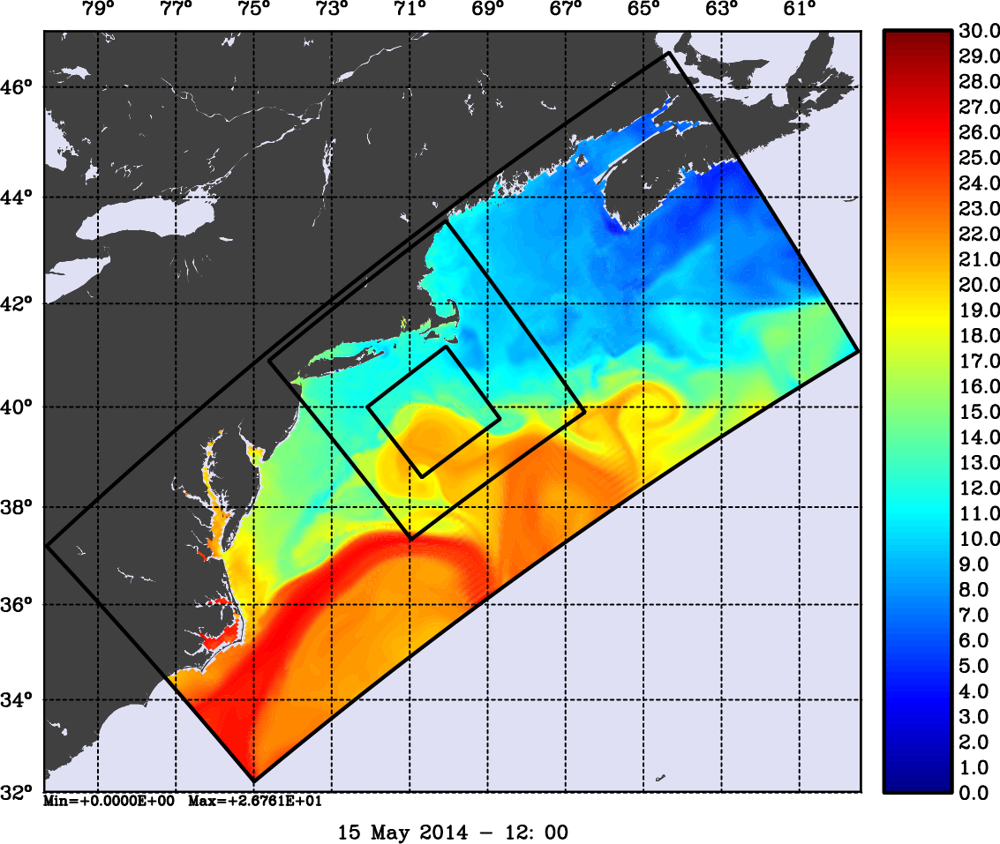
Two-Way DOPPIO-PIONEER-ARRAY
(1:3 Refinement)
Surface Temperature (Celsius)

Slide 38
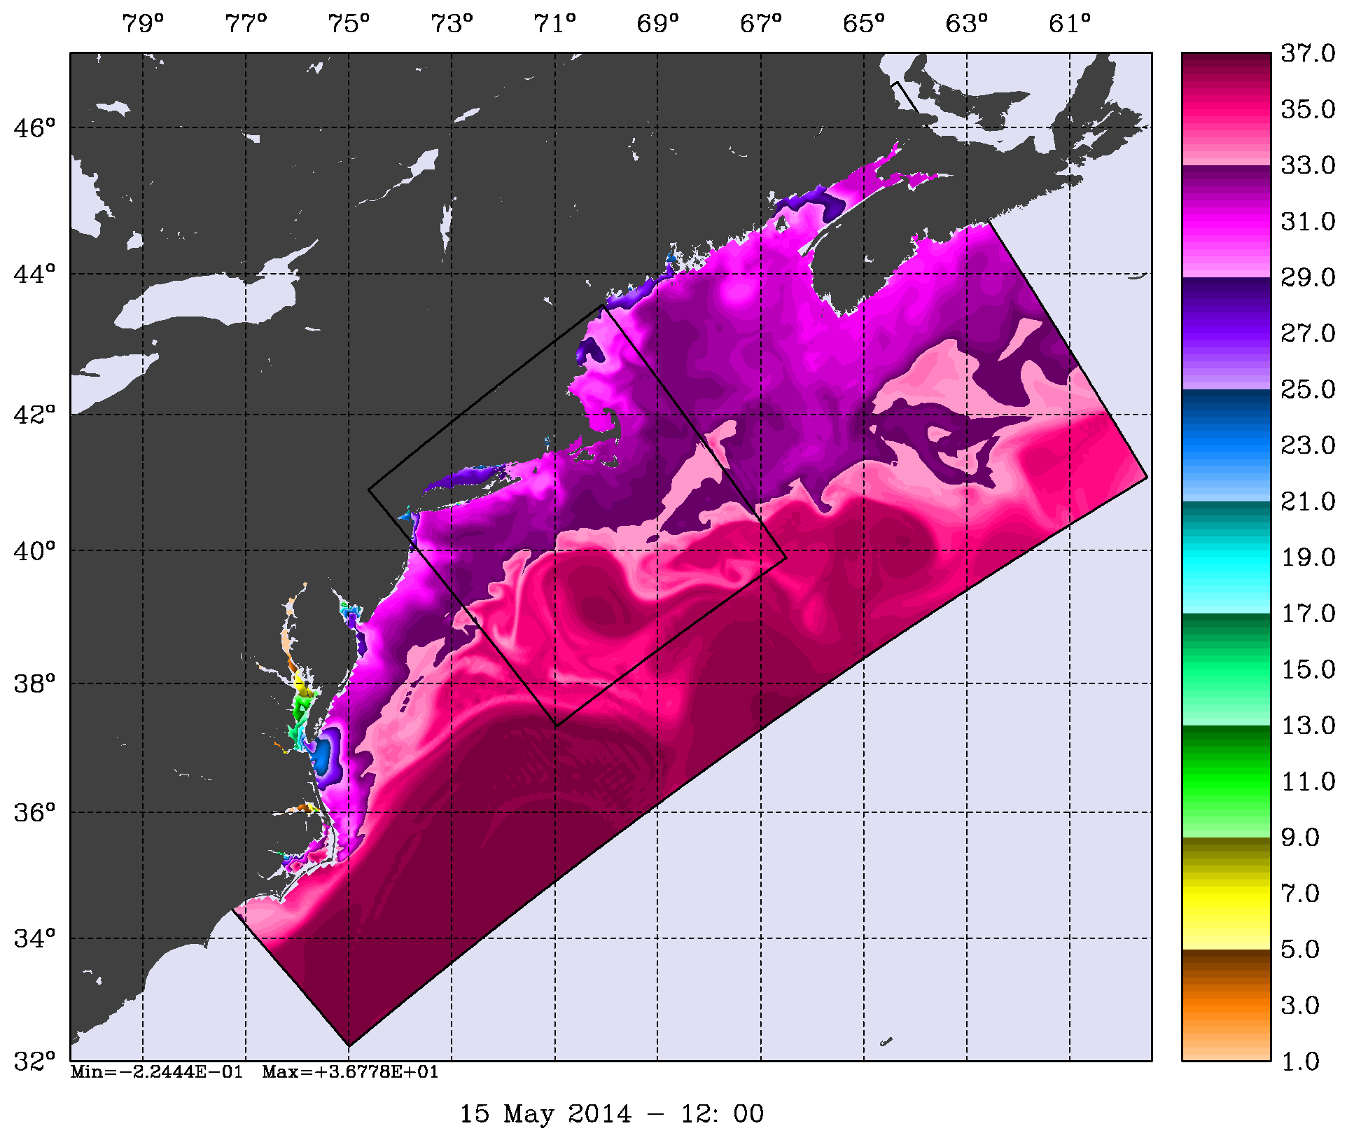
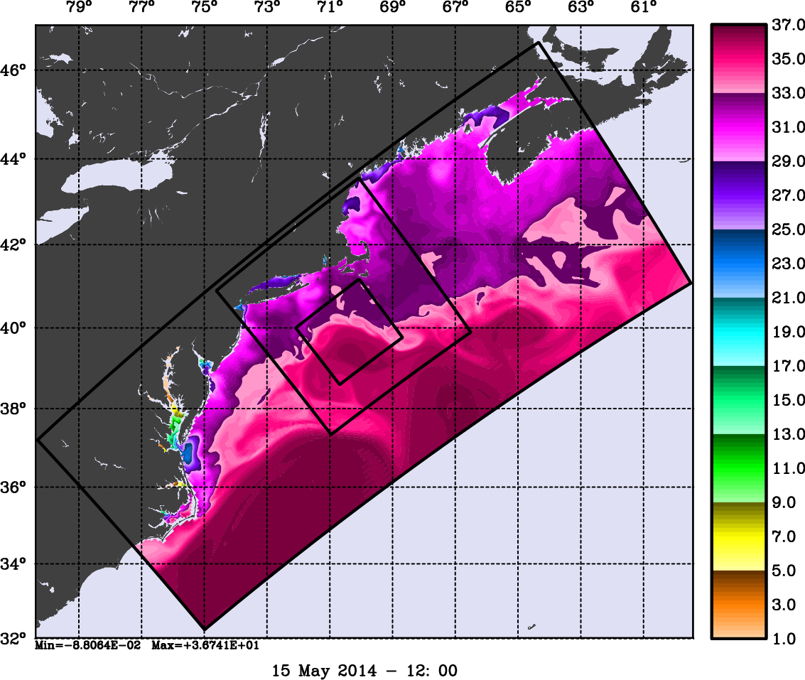
Two-Way DOPPIO-PIONEER-ARRAY
(1:3 Refinement)
Surface Salinity

Slide 39
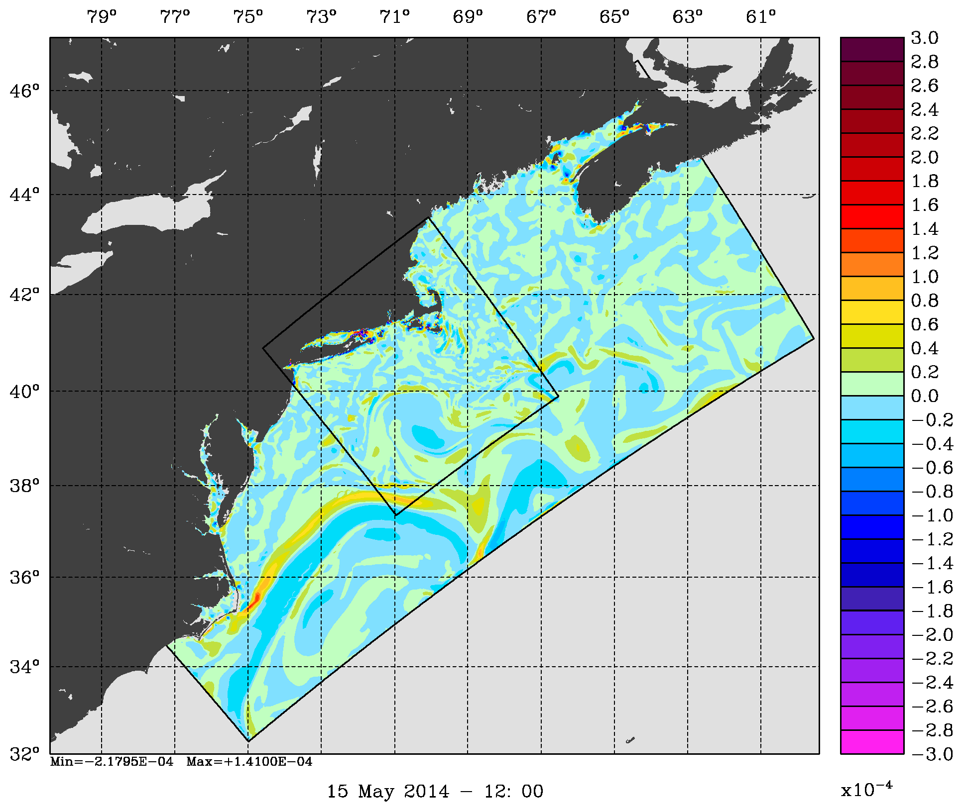
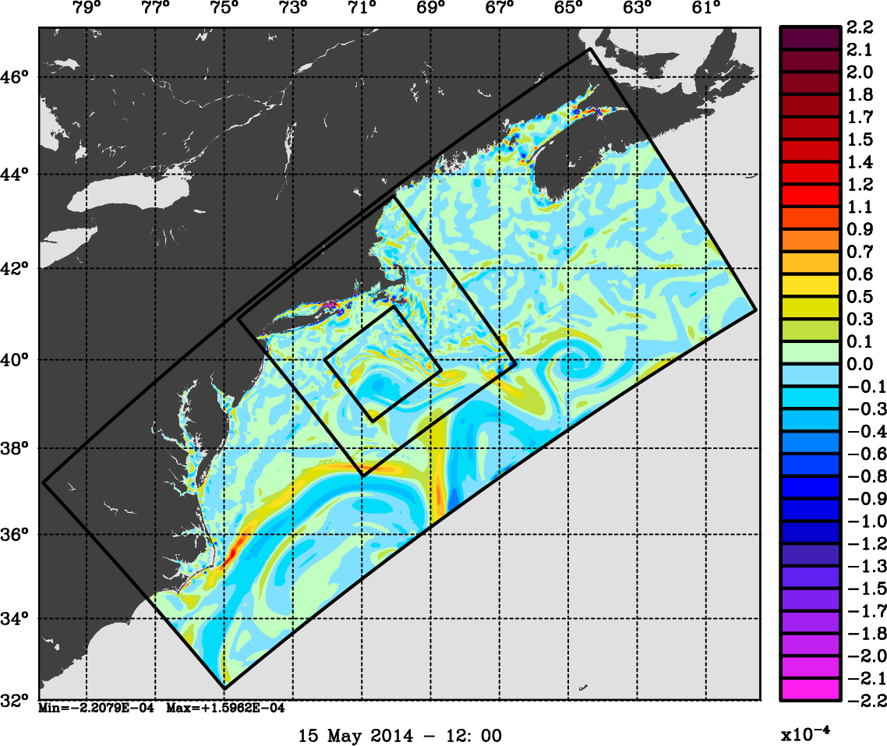
Two-Way DOPPIO-PIONEER-ARRAY
(1:3 Refinement)
Surface Relative Vorticity (1/s)

Slide 40
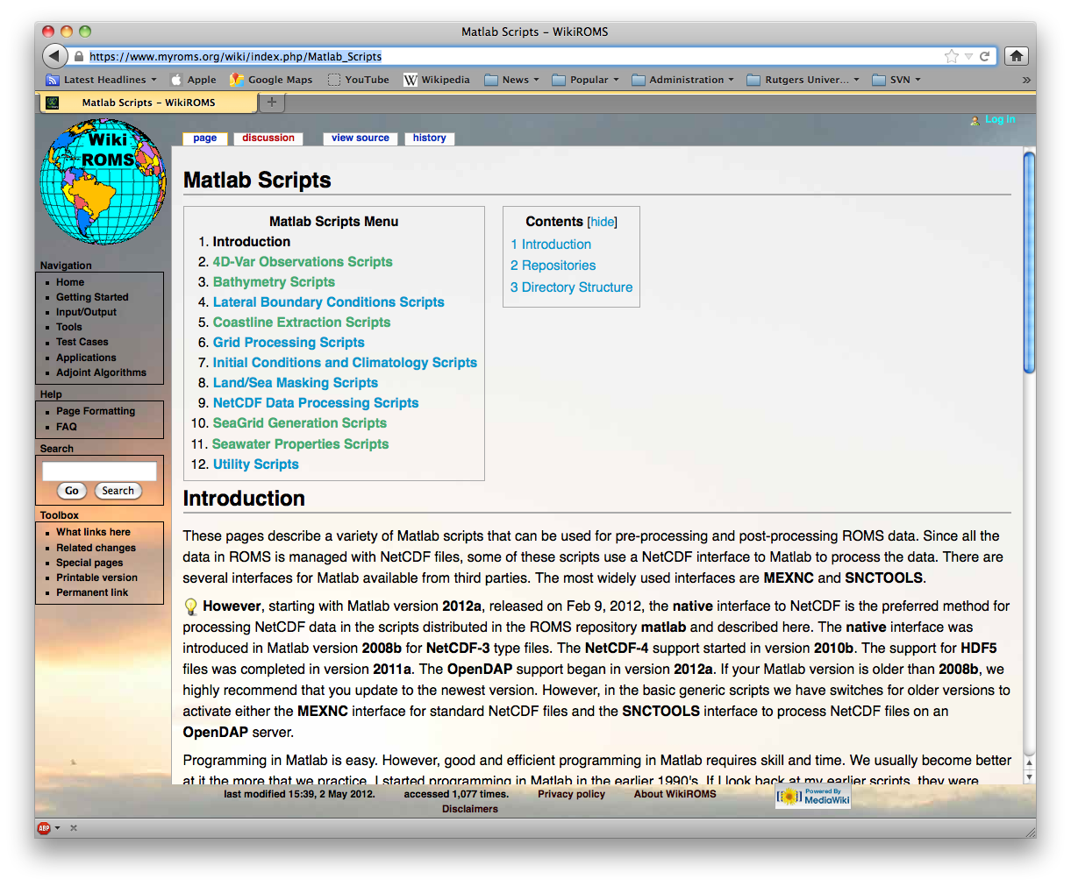
https://www.myroms.org/wiki/index.php/Matlab_Scripts

Slide 41
Remarks
ROMS nesting capabilities are unique and allow complex estuary and coastal configurations with unlimited number of composite and refined grids
Coincident composite and mosaic grids produce identical solutions when compared to one large continuous grid
Both one-way and two-way nesting are available but two-way is the default option
Placement of nested grids is application dependent and subject to geometrical and dynamical constrains

Slide 42
Reference
Warner, J.C., W.R. Geyer, and H.G. Arango, 2010: Using composite grid approach in complex coastal domain to estimate estuarine residence time, Computer and Geosciences, 36, 921-935, doi:10.1016/j.cageo.2009.11.008.

Slide 43
Contact Points Structure
integer :: Ncontact total number of contact regions
TYPE T_NGC
logical :: coincident coincident donor and receiver points, p=q=0
logical :: interpolate perform vertical interpolation
integer :: donor_grid data donor grid number
integer :: receiver_grid data receiver grid number
integer :: Npoints
integer, pointer :: Idg (:) donor grid, cell I-left index
integer, pointer :: Jdg (:) donor grid, cell J-bottom index
integer, pointer :: Kdg (: , :) donor grid, cell K-index
integer, pointer :: Irg (:) receiver grid, I-contact point
integer, pointer :: Jrg (:) receiver grid, J-contact point
real(r8), pointer :: Hweight (: , :) horizontal weights
real(r8), pointer :: Vweight(: , : , :) vertical weights
END TYPE T_NGC
TYPE (T_NGC), allocatable :: Rcontact (:) RHO-points
TYPE (T_NGC), allocatable :: Ucontact (:) U-points
TYPE (T_NGC), allocatable :: Vcontact (:) V-points

Slide 44
Lateral Boundary Conditions Structure
TYPE T_LBC
logical :: acquire process lateral boundary data
logical :: Chapman
logical :: clamped
logical :: closed
logical :: Flather
logical :: gradient
logical :: nested
logical :: nudging
logical :: periodic
logical :: radiation
logical :: reduced
END TYPE T_LBC
TYPE (T_LBC), allocatable :: LBC(:,:,:)
For example, for free-surface gradient boundary conditions we have:
LBC(iwest, isFsur, ng) % gradient
LBC(ieast, isFsur, ng) % gradient
LBC(isouth, isFsur, ng) % gradient
LBC(inorth, isFsur, ng) % gradient

Slide 45
Lateral Boundary Conditions Code
For Example, in zetabc.F the western boundary conditions are:
IF ( DOMAIN (ng) % Western_Edge(tile) ) THEN
IF ( LBC (iwest, isFsur, ng) % radiation ) THEN
…
ELSE IF ( LBC (iwest, isFsur, ng) % Chapman ) THEN
…
ELSE IF ( LBC (iwest, isFsur, ng) % clamped ) THEN
…
ELSE IF ( LBC (iwest, isFsur, ng) % gradient ) THEN
…
ELSE IF ( LBC (iwest, isFsur, ng) % closed ) THEN
DO j = Jstr, Jend
IF ( LBC_apply (ng) % west ( j ) ) THEN ! Allows both specified and
zeta ( Istr-1, j, kout ) = zeta ( Istr, j, kout ) ! nested conditions
END IF
END DO
END IF
END IF

